Slide 1
Understanding effectivity of metabolic interventions in melanoma
Zhang Mingjia
Supervisors
Prof. dr. Barbara M. Bakker
Dr. Mathilde Jalving
Dr. Rebecca Heiner-Fokkema

Slide 2
Contents
Background
Project aims and approach
Current work
Future Plan

Slide 3
1. Background

Slide 4

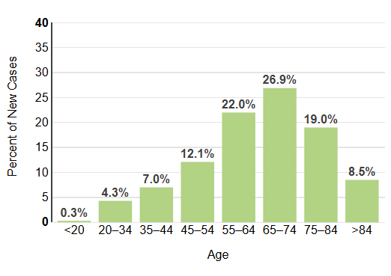

1.1 Epidemiology of melanoma
Increasing trend
Afflicting young and middle-aged people
Metastatic melanoma confers a poor prognosis
Notes:
Common type of skin cancer, historically is rare disease. Past 30 years, increasing trend.
We thought; higher incidence in old aged people
Early stage; easy treat
Media survival: less 1year
Incidence almost twice as high as in 2020

Slide 5
1.2 Treatment-Immunotherapy
WHY?
doi:10.1056/NEJMoa2407417
Notes:
Immuno check point inhibation
中心：block- (CTLA-4) (PD-1) –increase function of tcell-lpilimumab
CTLA-4 is considered the “leader” of the immune checkpoint inhibitors, as it stops potentially autoreactive T cells at the initial stage of naive T-cell activation.
The PD-1 pathway regulates previously activated T cells at the later stages of an immune response. -nivolumab
Similar to CTLA-4 signaling, PD-1 binding inhibits T-cell proliferation, and interferon-γ (IFN-γ), tumor necrosis factor-α, and IL-2 production, and reduces T-cell survival.

Slide 6
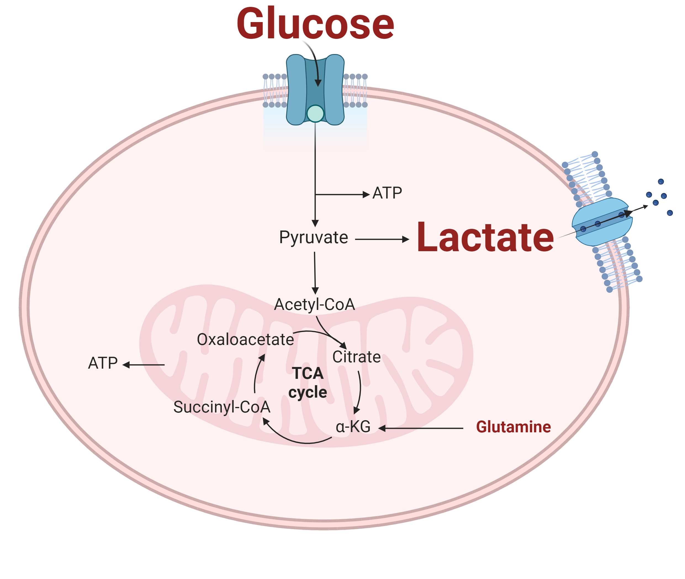
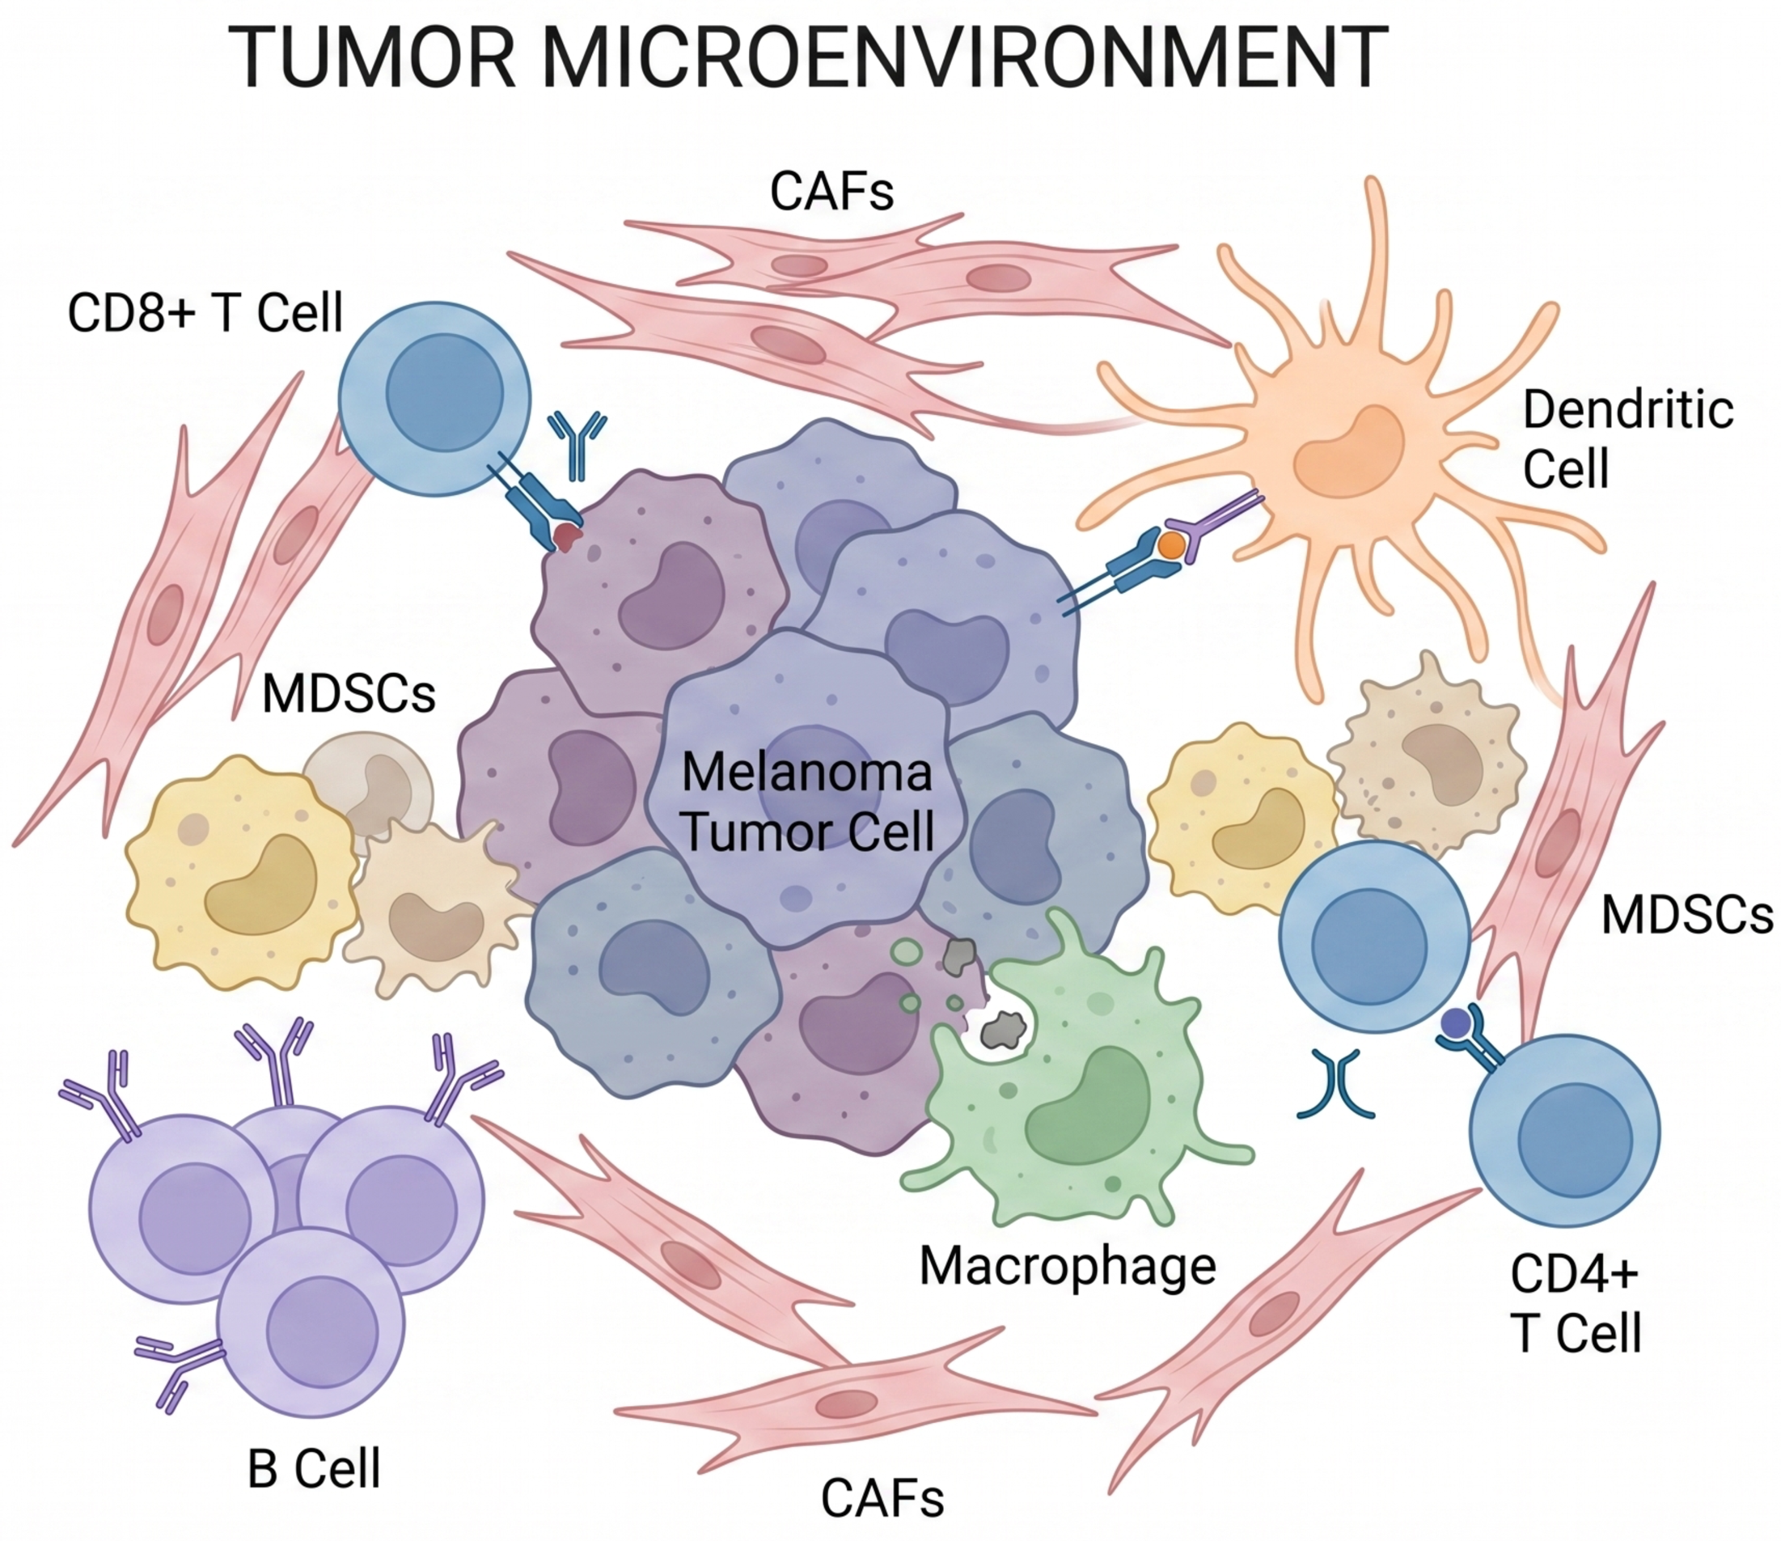


1.3 Immunotherapy and tumour microenvironment(TME)
Cancer cells have high glycolytic rates/Warburg effect
Lactate
pH↓
Acidification in TME
T-cell
Attenuating the anti-tumour immune response
Notes:
解释TME-肿瘤组织内的微环境，肿瘤细胞+其他细胞 定义：difinate
glucose levels
secretion of lactate and carbon dioxide CO2 .
more successful in the uptake of scarce nutrients
overexpression of metabolic transporters.
adaptive mechanisms, such as autophagy and the inhibition of lysosomal proteolysis
CAFs 肿瘤成纤维细胞
MDSCs骨髓来源的抑制性细胞或髓源性抑制细胞

Slide 7
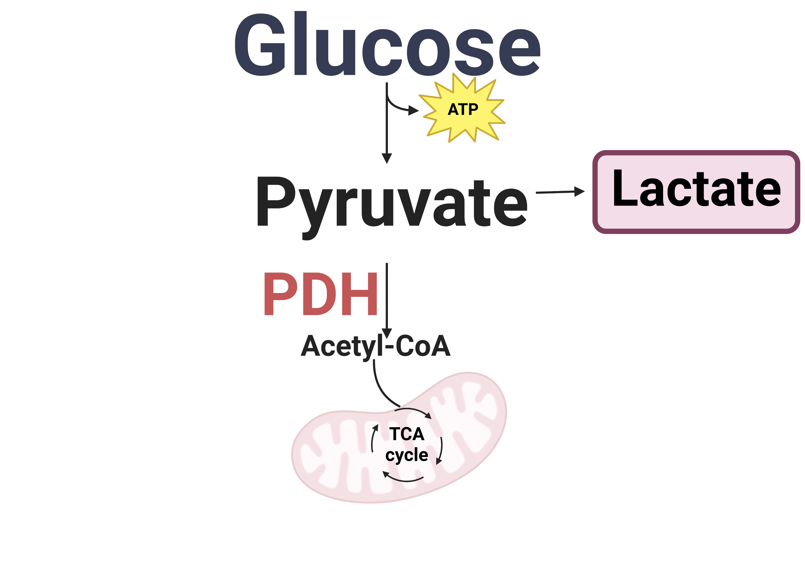
1.4 Repurposing an old drug
Dichloroacetate (DCA):
Reroute glucose metabolism
Limiting lactate production
DCA
PDK
Does DCA suit every patient?
Notes:
LDH-A knockdown tumors showed increased infiltration of CD8⁺ T cells and NK especially when combined with anti-PD-1 therapy. But not safe
Preliminary results show that dichloroacetate (DCA), a clinically approved inhibitor of pyruvate dehydrogenase kinase (PDK), can reroute glucose metabolism into mitochondrial respiration, thereby limiting lactate production. This may serve a dual purpose: besides inhibiting tumour growth, DCA is expected to reduce the acidification of the tumour environment and thereby improve the response to immune checkpoint inhibitors ICIs.
黑色素瘤细胞经常表现出较高的葡萄糖摄取率和乳酸生成率。宿主研究所的初步研究结果表明，二氯乙酸（DCA）是一种已获临床批准的丙酮酸脱氢酶激酶（PDK）抑制剂，可将葡萄糖代谢转入线粒体呼吸，从而限制乳酸的产生。这可能具有双重作用：除了抑制肿瘤生长外，DCA 还有望降低肿瘤环境的酸化程度，从而改善对 ICIs 的反应。
Melanoma and other rapidly proliferating cancerous and non-cancerous cells reprogram metabolism, to meet the proliferative demands i.e. producing building blocks for growth, generation of ATP and maintenance of redox balance. This altered metabolism is critical for tumour growth and introduces metabolic vulnerabilities that can potentially be exploited as therapeutic targets. Besides potentially reducing tumour growth, drugs targeting tumour metabolism may also help promote an effective anti- tumour immune response by improving the metabolic circumstances for anti-cancer immune cells in the tumour microenvironment14.

Slide 8
2. Project aims and Approach
Notes:
different patient-derived melanoma tumours can have distinct metabolic signatures
a key challenge will be to define what kind of metabolic phenotype in melanoma cells confers optimal DCA response before translating DCA as standard therapy into the clinic

Slide 9

Main Aim
Proteome information
A computational model
Suitable for DCA
No DCA

Slide 10
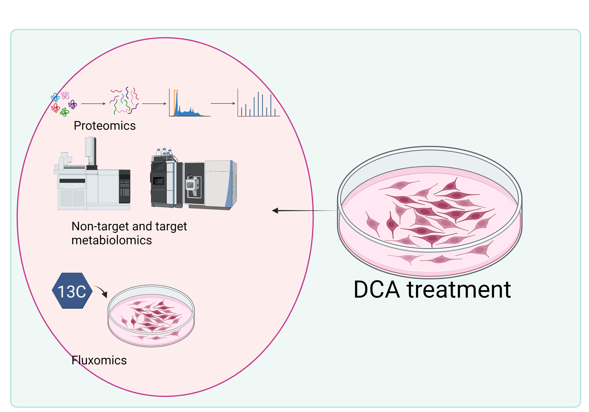
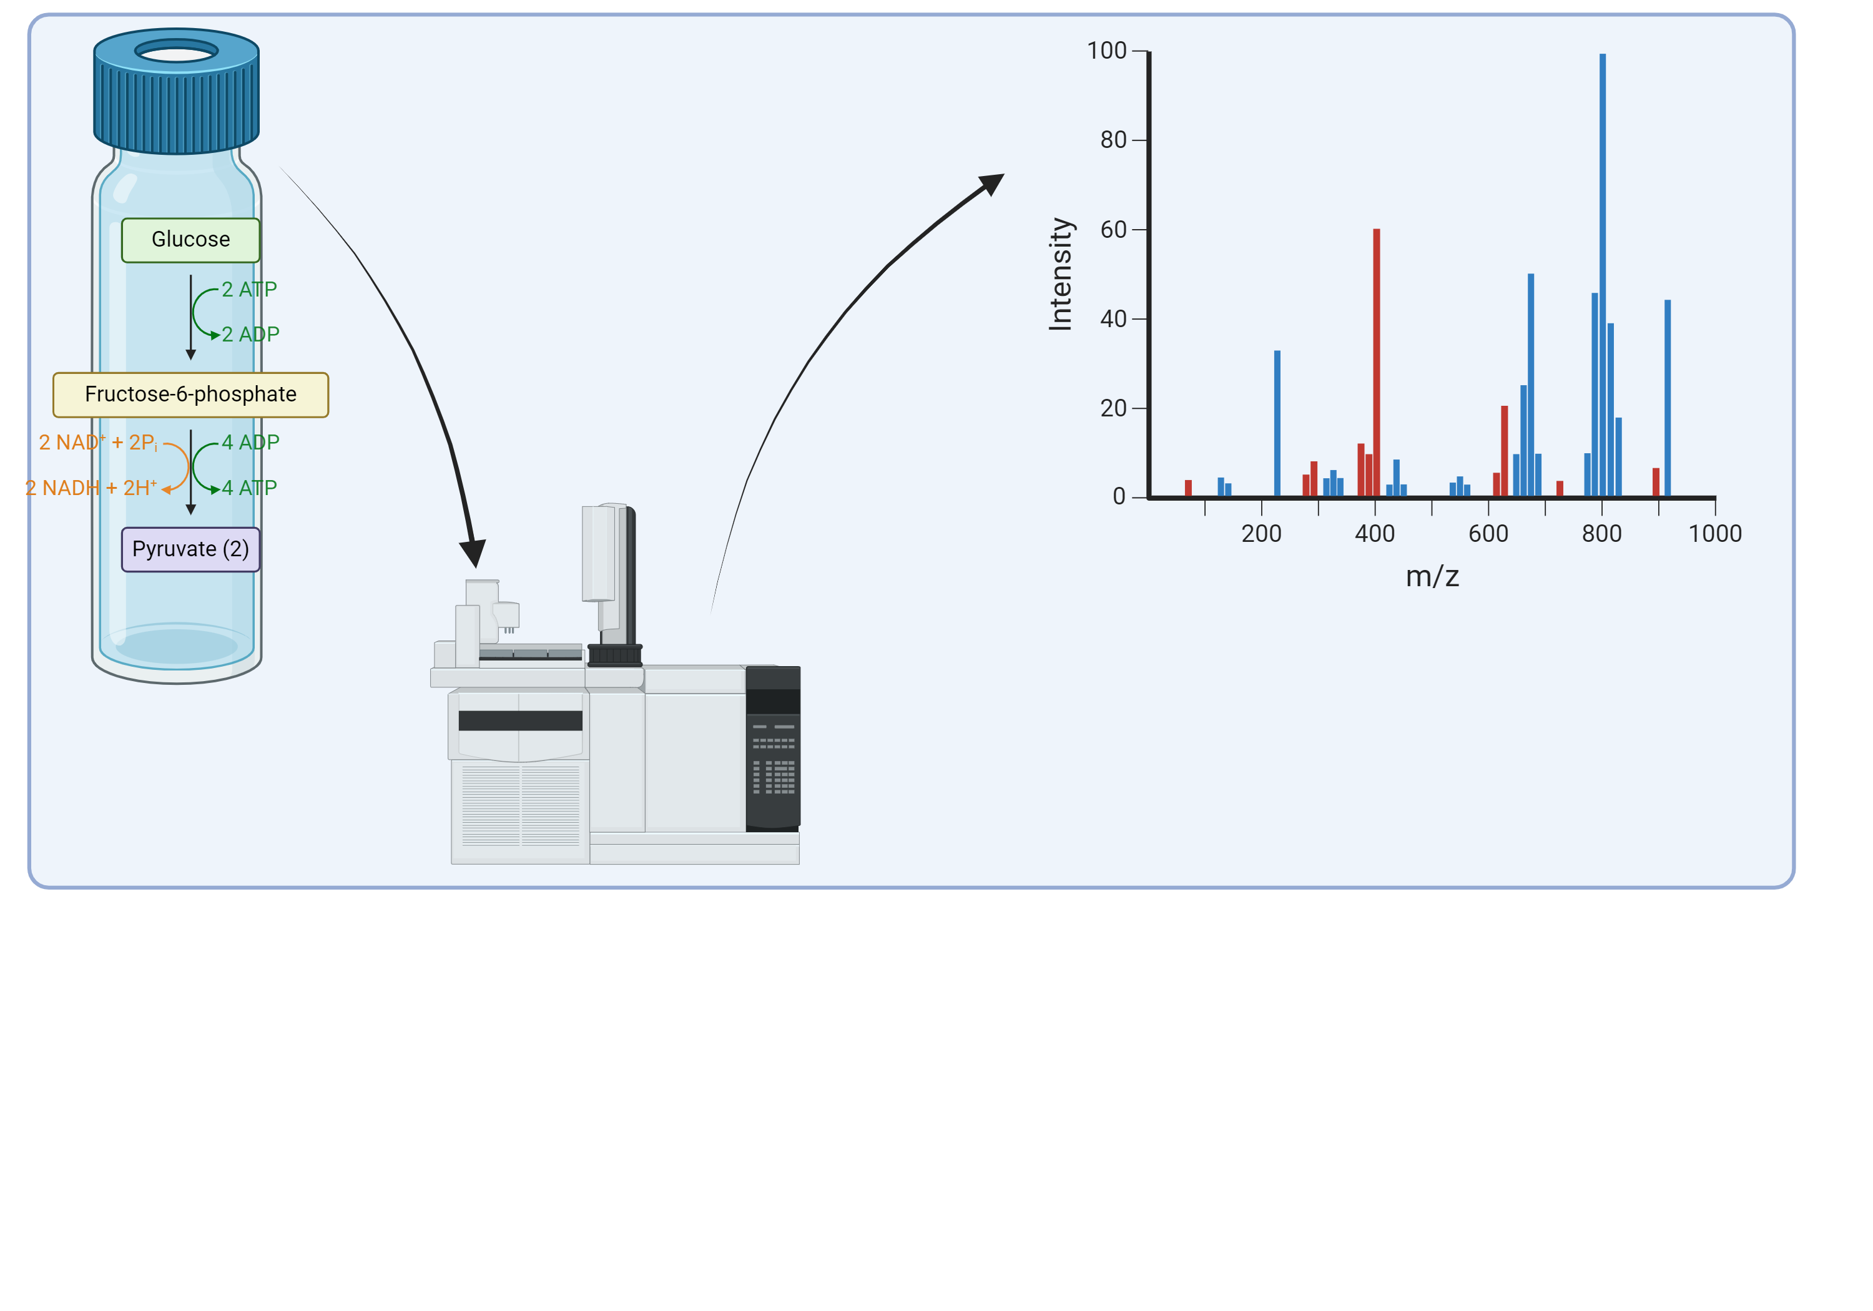
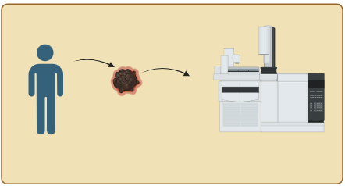
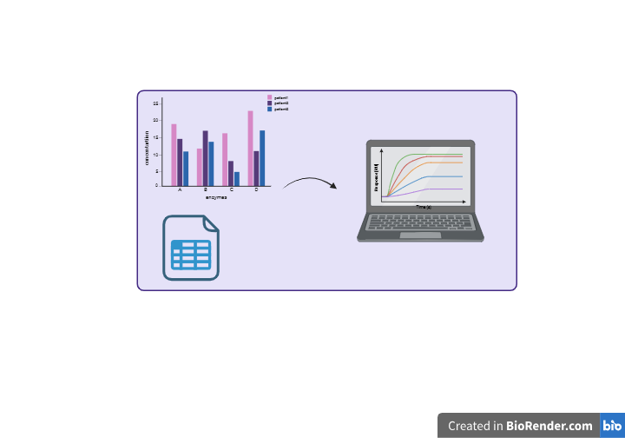
Aims and Workflow
Method Development
Multi-omics
Pathological tissue
DCA treated melanoma in vivo
Cell-line-specific computational models
Notes:
Ordinary differential equations
Enzyme kinetic equation

Slide 11
3. Current Result
Baseline metabolic phenotype
DCA treatment effect

Slide 12
Methods
TCA cycle Flux
Glycolysis and PPP flux
Enzyme activities and concentrations
Glucose consumption and lactate production

Slide 13
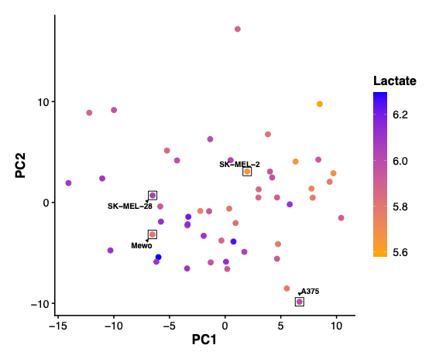
Public metabolism database PCA analysis
Lina siampakou, (2025)

Slide 14
A375 and SK-MEL-2 show most difference DCA sensitivity
Half maximal inhibitory concentration (IC50) curves of DCA
IC50 values of DCA
Evers, B. (2022). Repurposing an old drug
Notes:
A375-BRAF-half-40-50%
SKMEL2-NRAS-15-20%
Acidfication inhibit cytokine

Slide 15

Metabolic phenotype of different melanoma cell lines
Glucose uptake and lactate production in A375 and SK-MEL-2 cells.
A375 has highly glycolytic rate
Evers, B. (2022). Repurposing an old drug
Notes:
Flux，plot，A375 high active glycolysis pathway
酶的最大催化活性(Vmax)等于产物kcat·[E]，其中kcat为酶的催化周转数，[E]为酶的浓度。
我们发现A375细胞中大多数糖酵解酶的Vmax高于SK-MEL-2细胞(图1c、1d和S3)。己糖激酶(HK)和磷酸果糖激酶(PFK)被认为对癌细胞中的糖酵解通量具有高度的控制作用40,41。
与此相一致的是，尽管蛋白质浓度相似，但A375细胞中HK和PFK的Vmax值明显高于SK-MEL-2细胞(图1c-1e和S4a)。相反，葡萄糖-6-磷酸脱氢酶glucose-6-phosphate dehydrogenase (G6PDH)和磷酸甘油酸激酶(PGK)的Vmax在SK-MEL-2细胞中由于酶浓度的增加而显著升高(图1d和1e)。较高的G6PDH活性刺激葡萄糖-6-磷酸(G6P)进入戊糖磷酸途径(PPP)，这将限制SK-MEL2细胞中葡萄糖向LAC的化学计量转化(图1a)42,43。PGK1是最重要的PGKprominent PGK isoenzyme同工酶，普遍存在于所有细胞中44,45。目前尚不清楚为什么PGK活性在糖酵解较少的细胞中较高

Slide 16
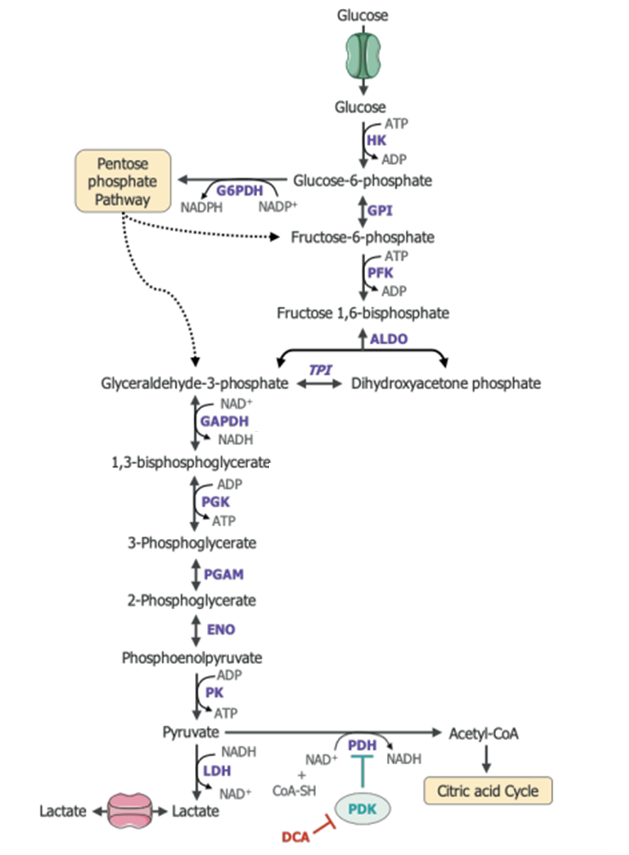
Enzymes’ Vmax in glycolysis pathway
PPP flux is higher in SK-MEL-2?
Evers, B. (2022). Repurposing an old drug
Notes:
Red， blue
Confirm A375 have active glycolysis pathway

Slide 17
Flux omics---Steady state
Metabolite pool
Glucose (substrate)
G6P
F6P
Pyruvate
TCA cycle
Notes:
flow

Slide 18
Add [U-¹³C]-glucose
[U-13C]-glucose
Glucose
(substrate)
G6P
F6P
Pyruvate
TCA cycle

Slide 19
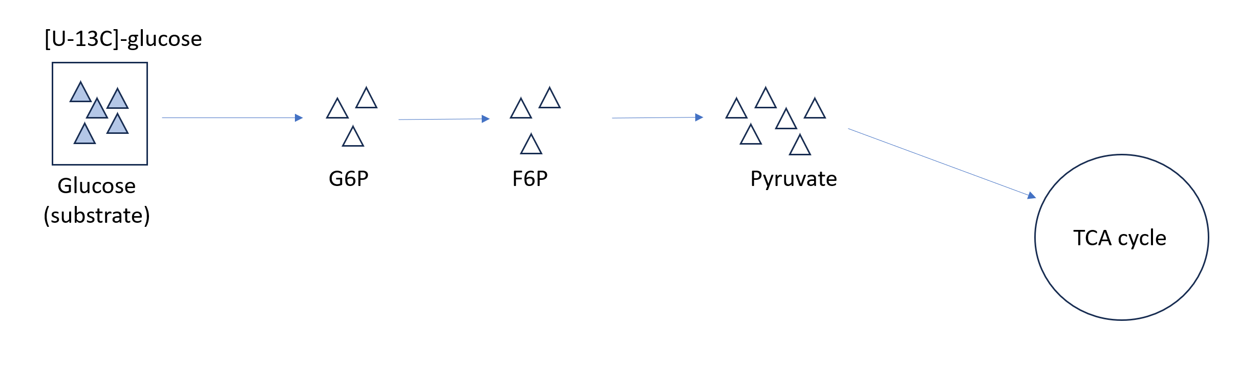
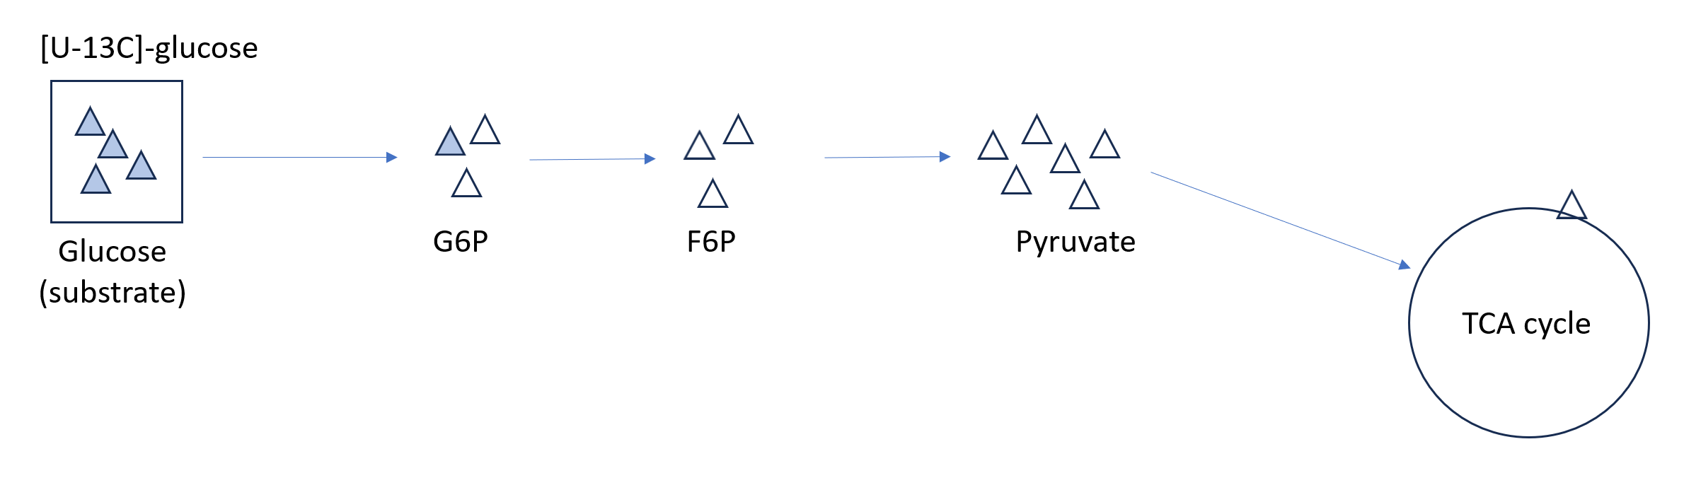
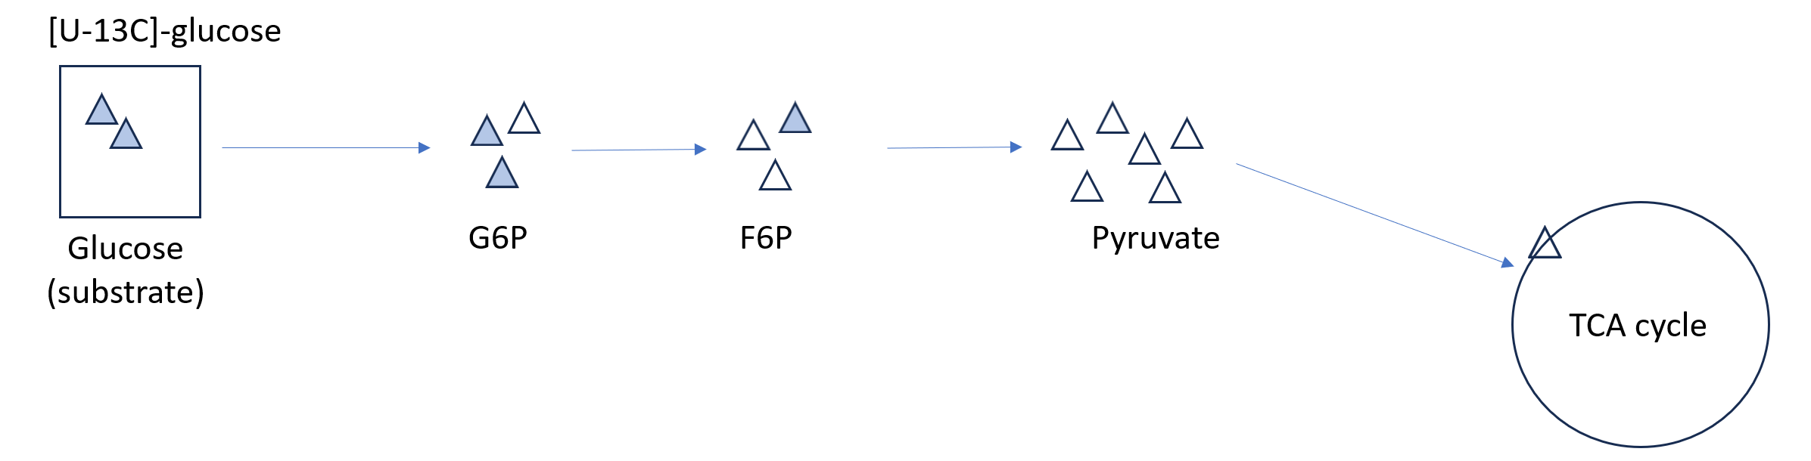
Time course experiment
T0
T1
T2

Slide 20
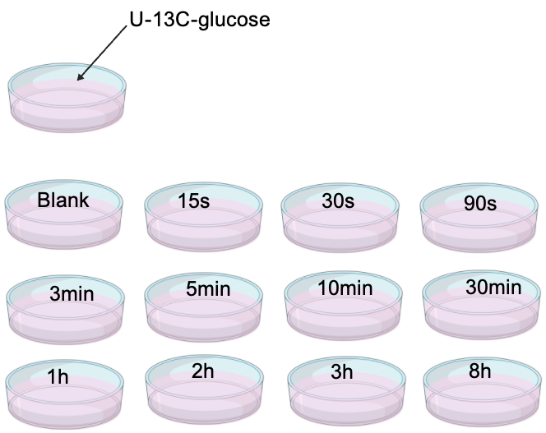
Glycolysis and PPP flux measurement
Glycolysis pathway always goes very fast
GC-MS/MS has been used for measuring labelling fraction and concentration
INCA is used to calculate the flux
*3
S7P’s labelling pattern and concentration

Slide 21
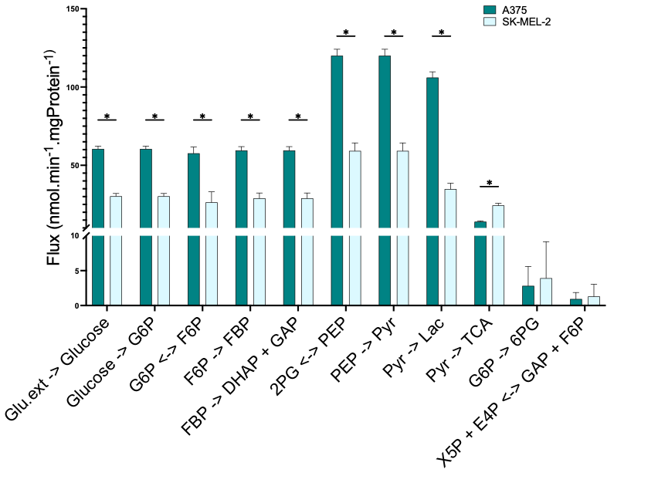
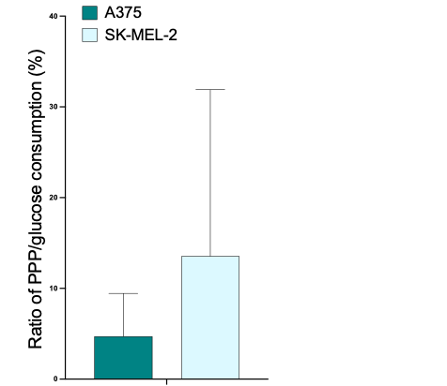
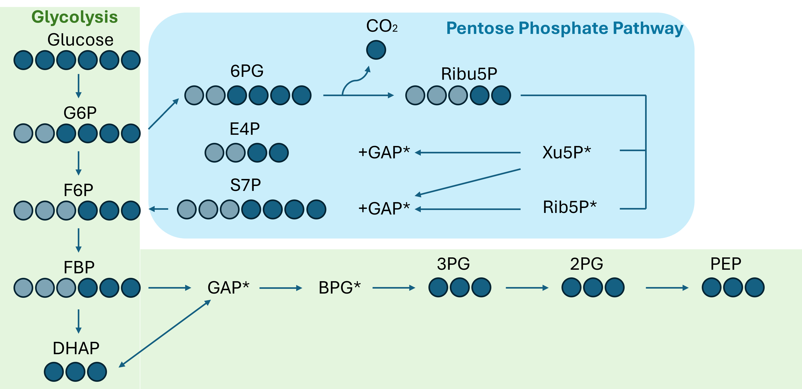
Glycolysis flux comparison in A375 and SK-MEL-2 control
Ratio of G6P->6PG/glucose->G6P flux comparison
in A375 and SK-MEL-2 control

Slide 22
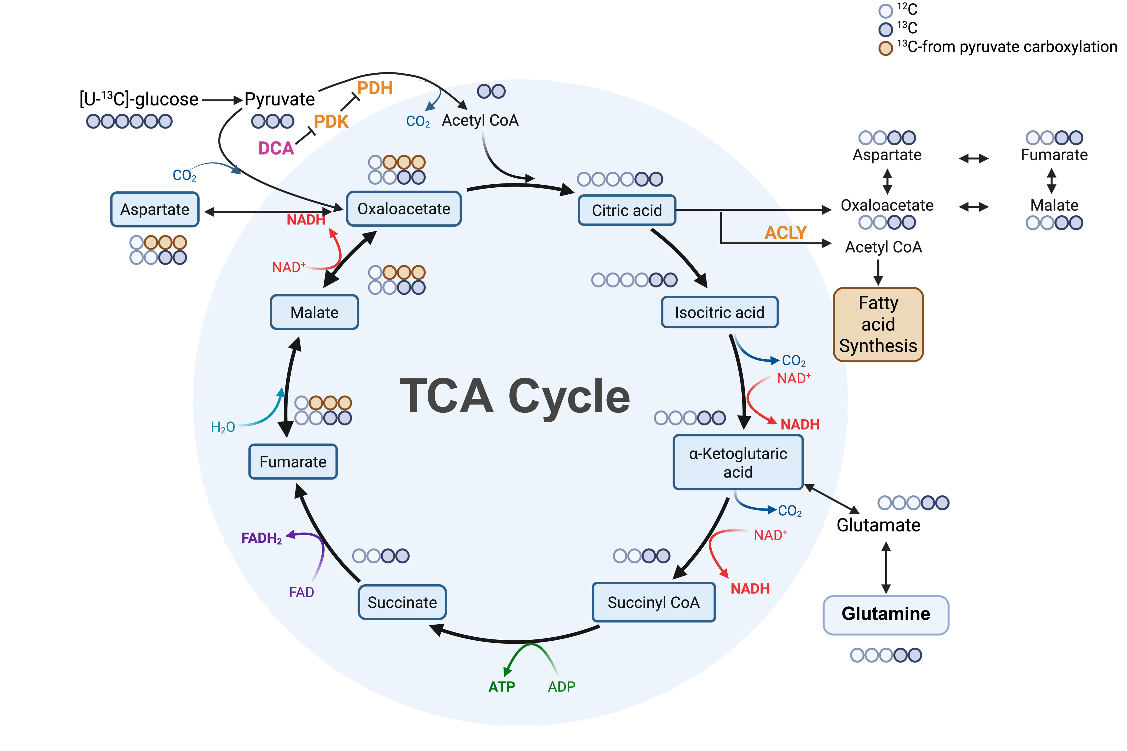
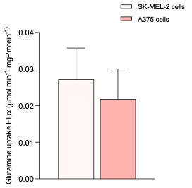
Glutamine uptake flux

Slide 23
A375 vs. SK-EML-2 proteomics in TCA cycle
SK-MEL-2 cells exhibit higher oxidative TCA cycle activity than A375

Slide 24
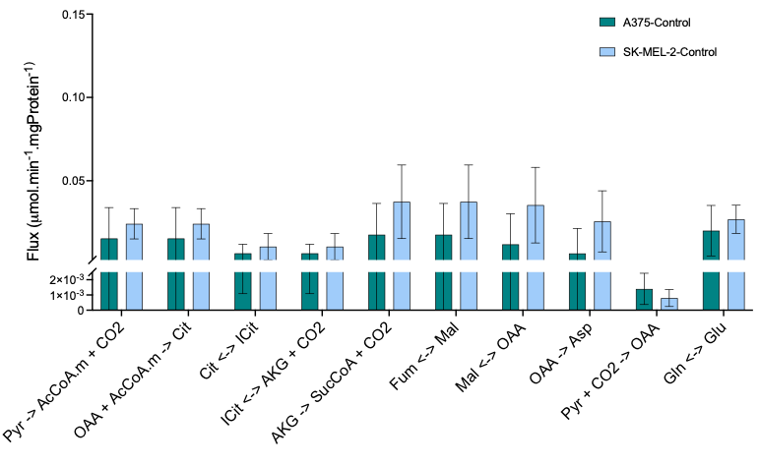
TCA cycle flux comparison between cell lines

Slide 25
Summary for baseline phenotype
The A375 cells :
Highly glycolytic phenotype and high lactate production
The SK-MEL-2 :
High oxidative TCA cycle
Less active glycolysis pathway

Slide 26
Glucose and lactate flux Control vs. DCA
Fraction of pyruvate through PDH
DCA
- +
- +
A375
SK-MEL-2
Does pyruvate re-direct to TCA?

Slide 27
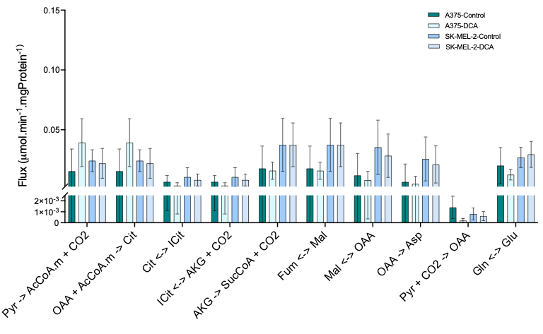
TCA flux Control vs. DCA

Slide 28
Simulation of citrate through ACLY

Slide 29
A375 cell line Vmax change in Glycolysis after DCA treatment
Reflect on flux level?

Slide 30
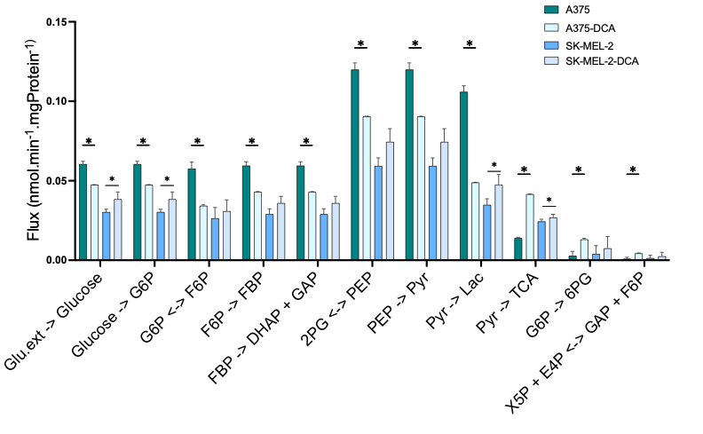
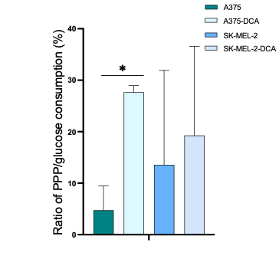
Glycolysis Flux comparision control vs. DCA

Slide 31
S7P’s labelling pattern and concentration

Slide 32
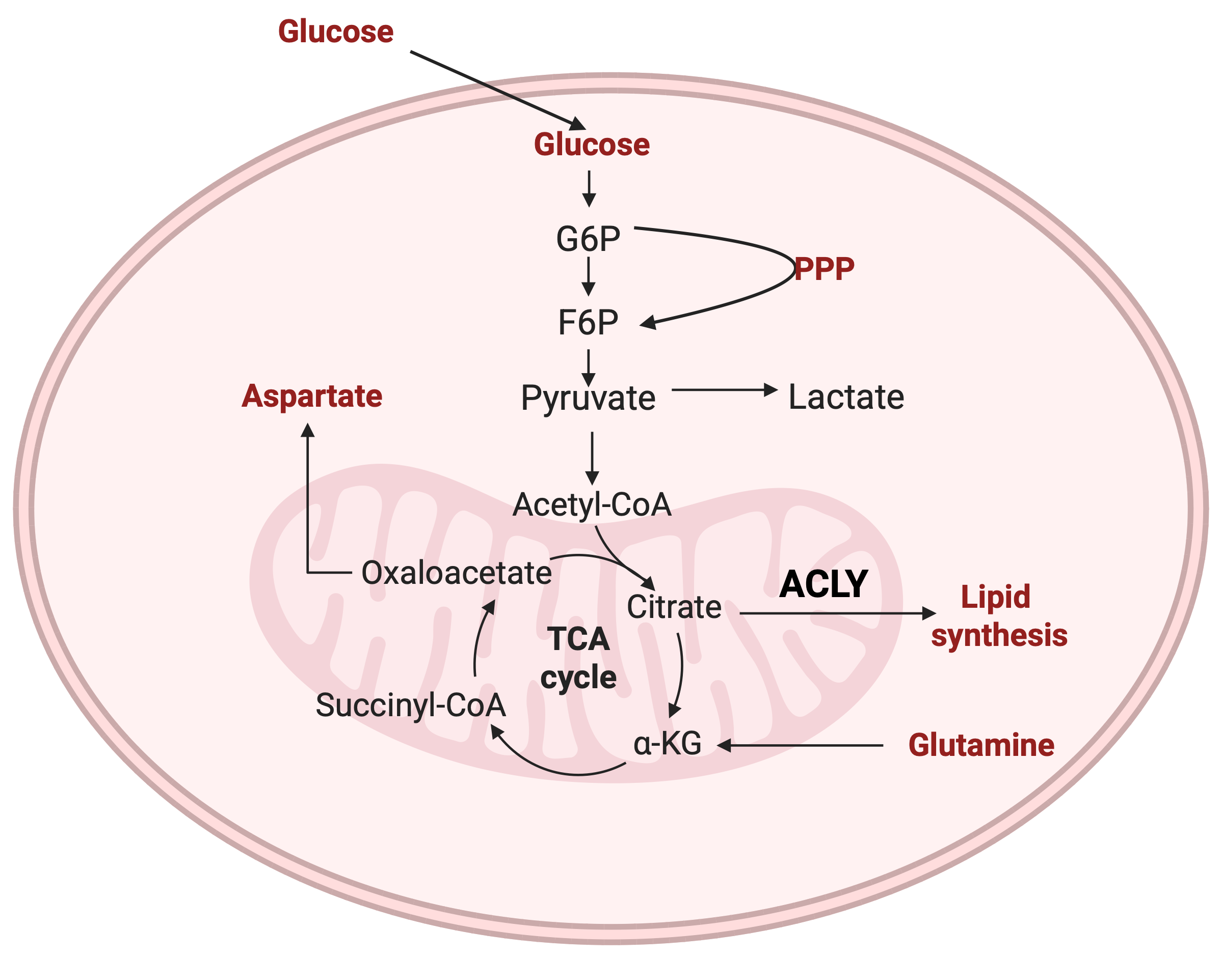


Conclusion-A375

Slide 33
Conclusion-SK-MEL-2

Slide 34
4. Future Plan
Computational model based on enzyme kinetics
Mice experiment

Slide 35


Acknowledgement
Barbara. M. Bakker
Rebecca Heiner-Fokkema
Hilde Jalving
Albert Gerding
Anna Wijngaard
Bernard Evers
Karen van Eunen
Miriam Langelaar-Makkinje
Theo Boer

Slide 36
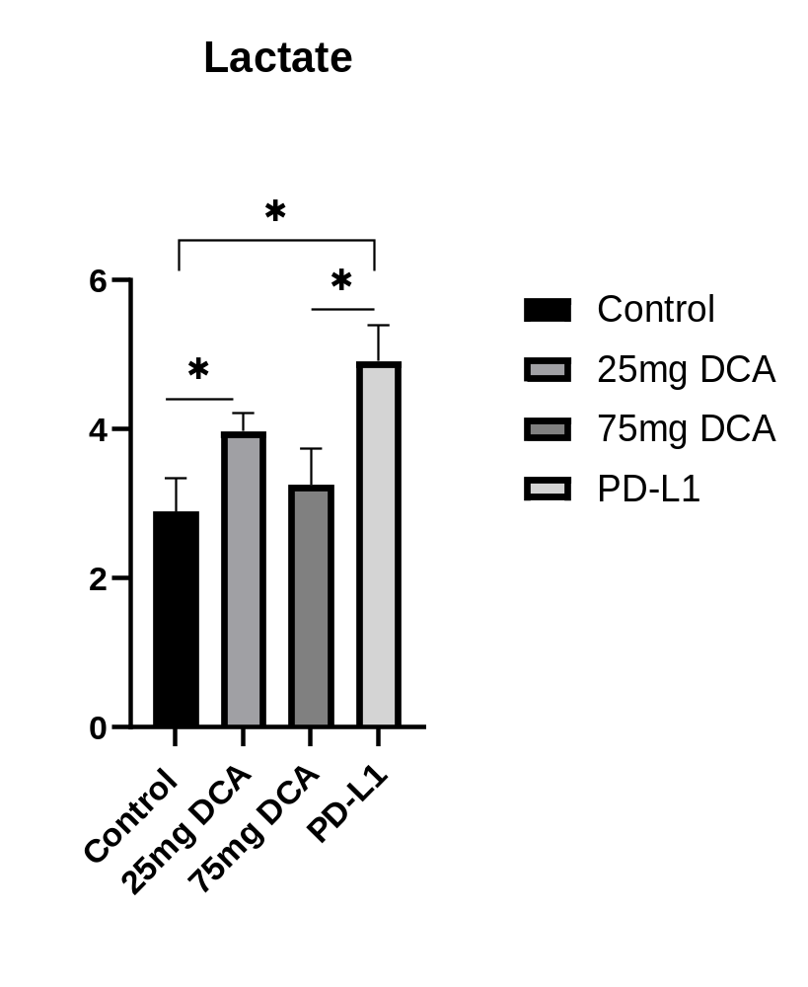

Slide 37
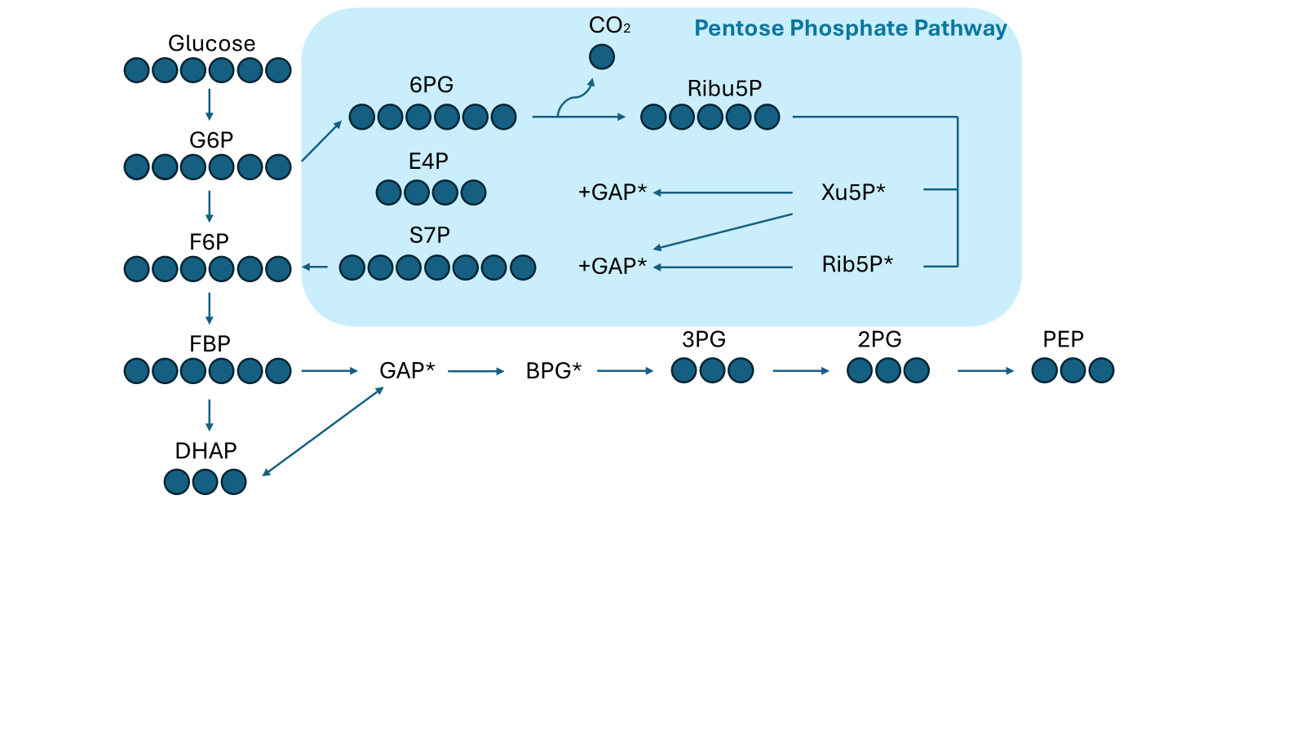
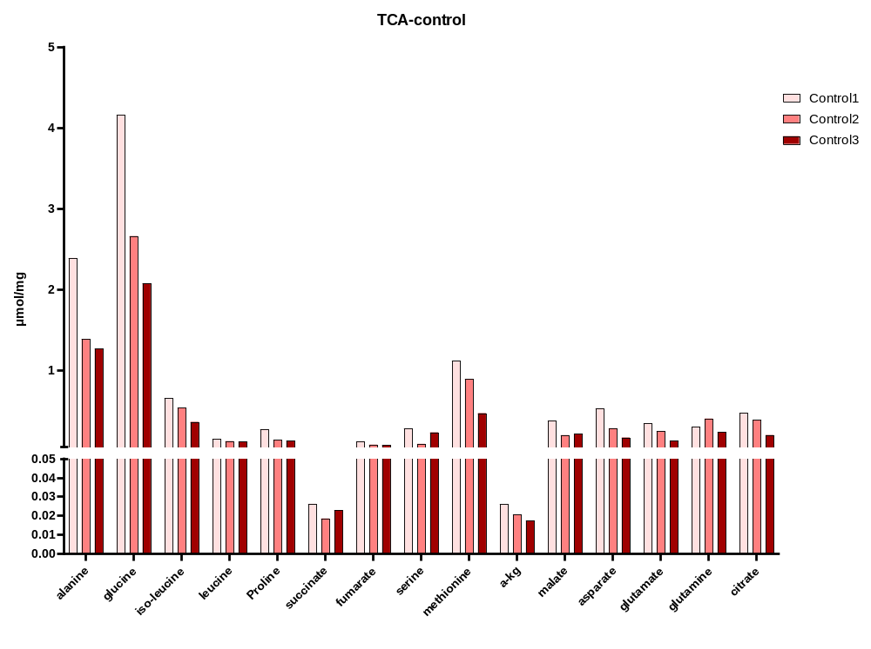
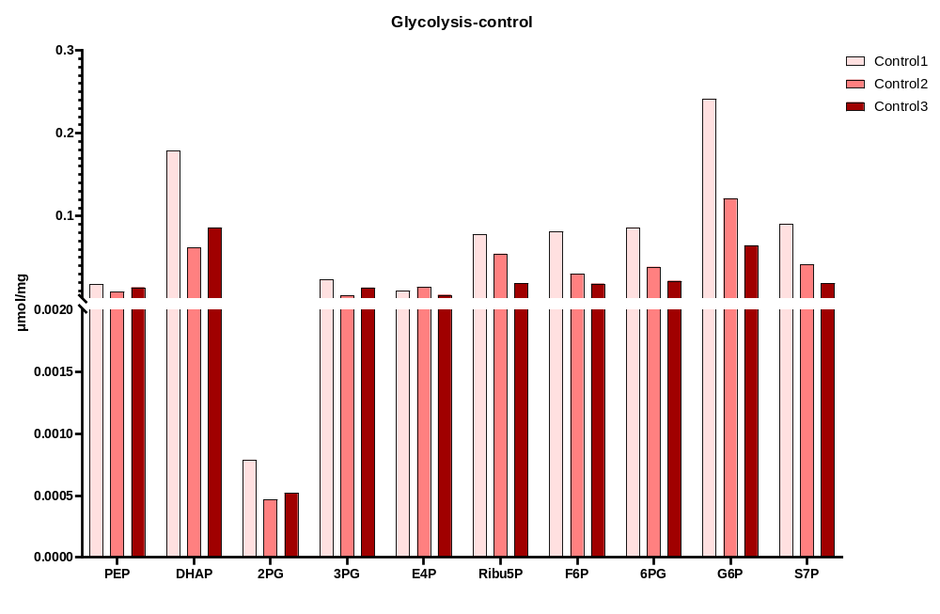
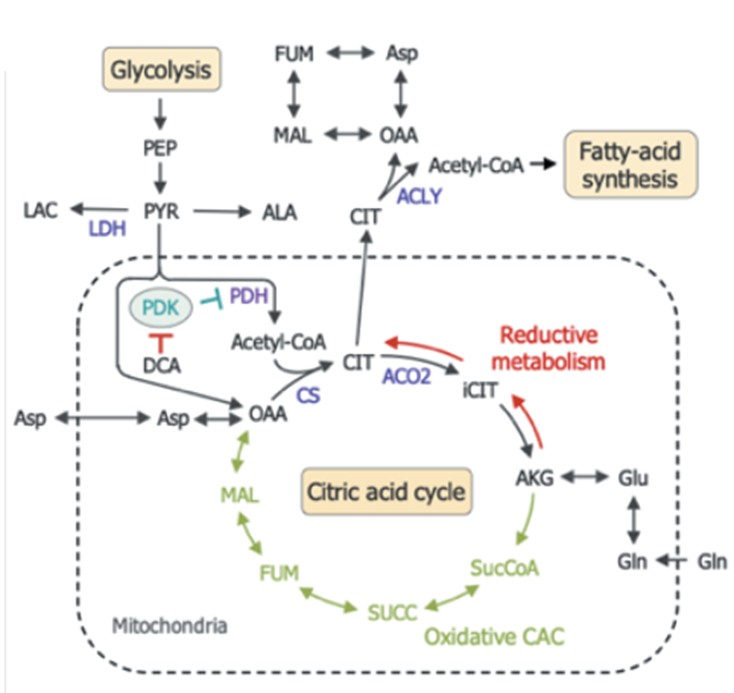
Control
Leucine
Iso-leucine
Methionine

Slide 38
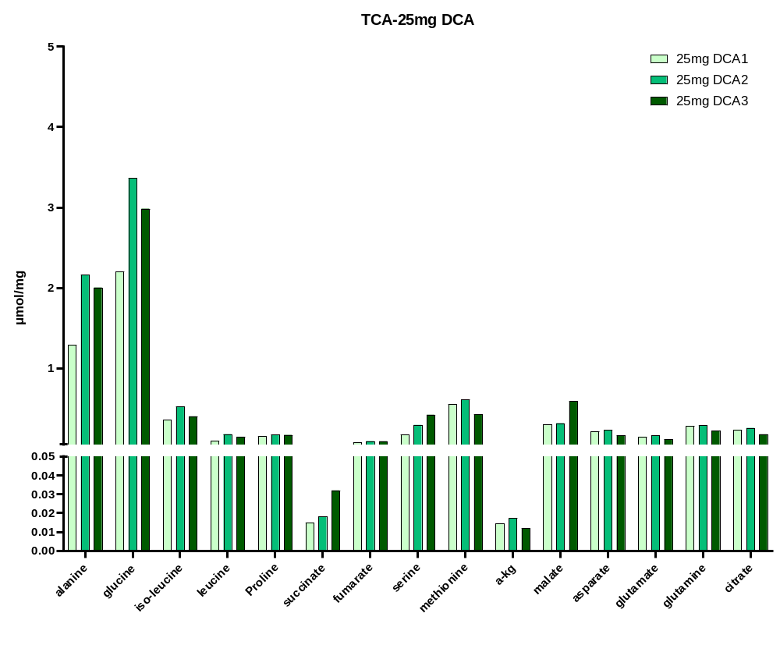
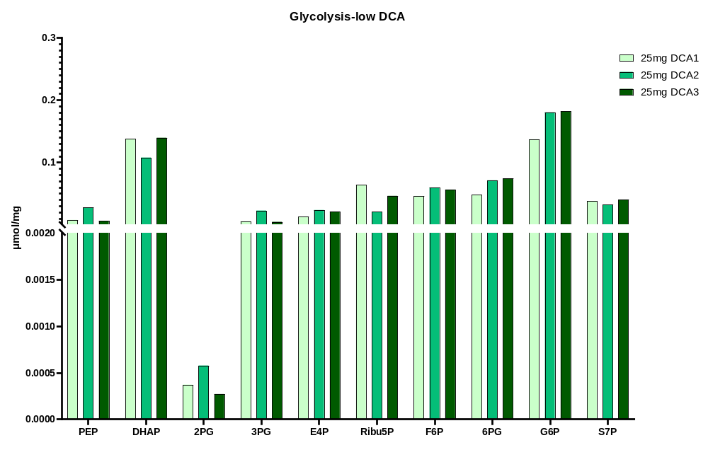
25mg DCA
Leucine
Iso-leucine
Methionine

Slide 39
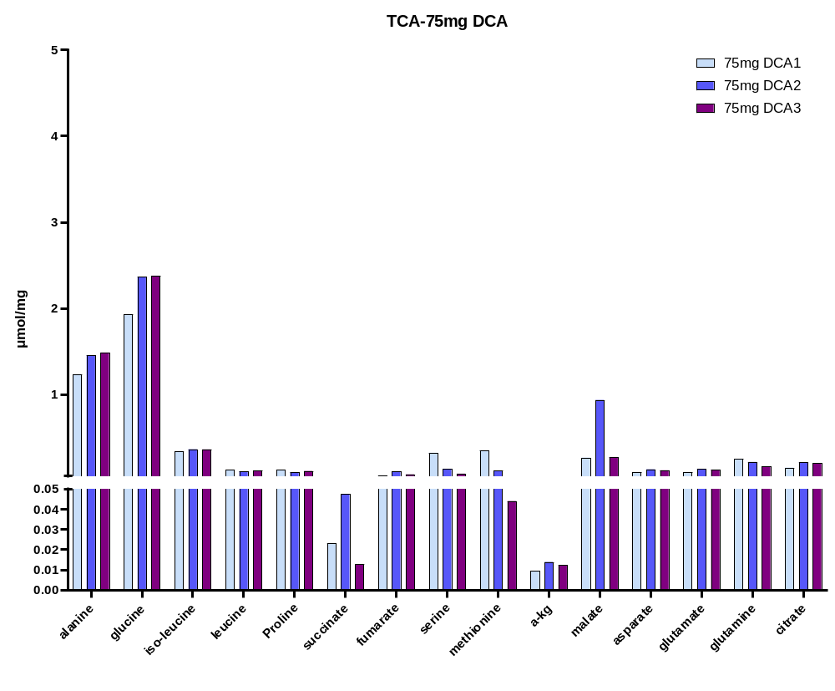
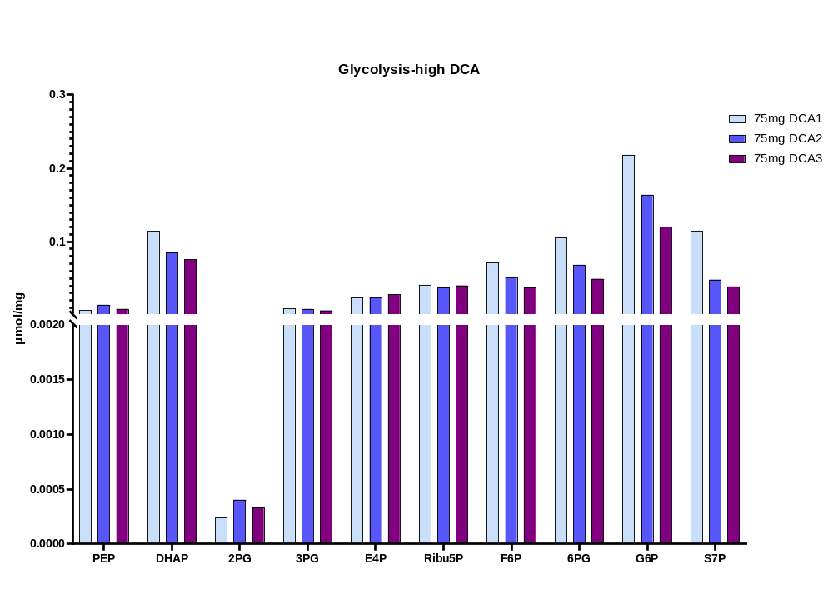
75mg DCA
Leucine
Iso-leucine
Methionine

Slide 40
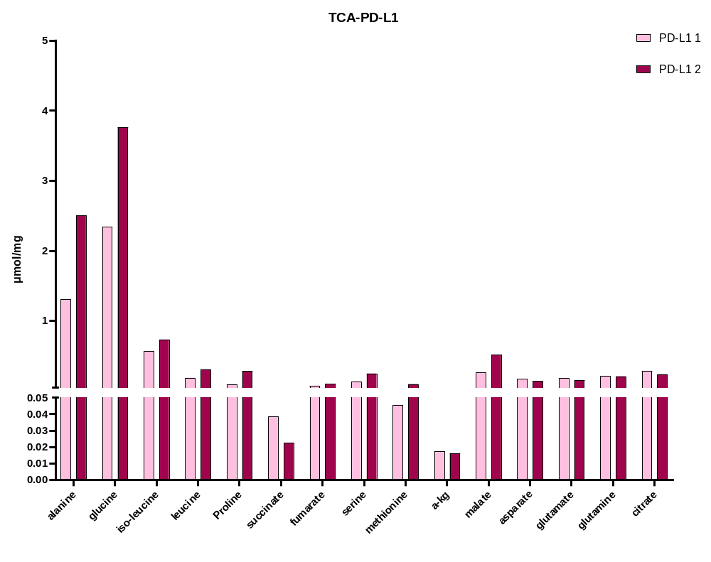
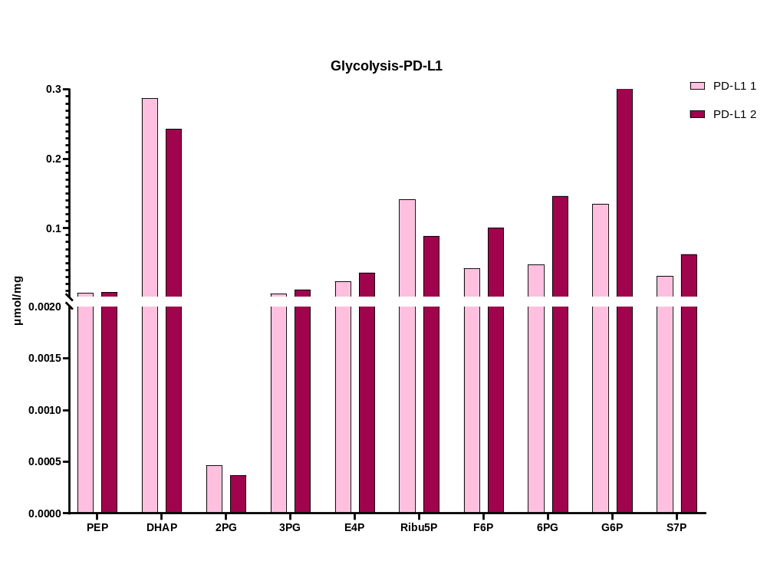
PD-L1
Leucine
Iso-leucine
Methionine

Slide 41
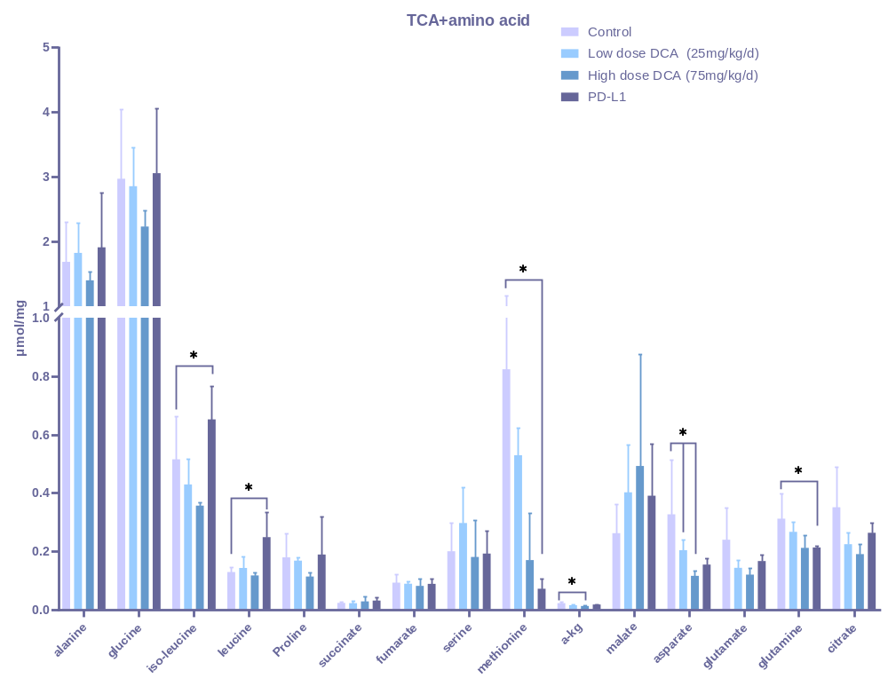
Does DCA changed the TCA intermediates concentration?
Leucine
Iso-leucine
Methionine

Slide 42
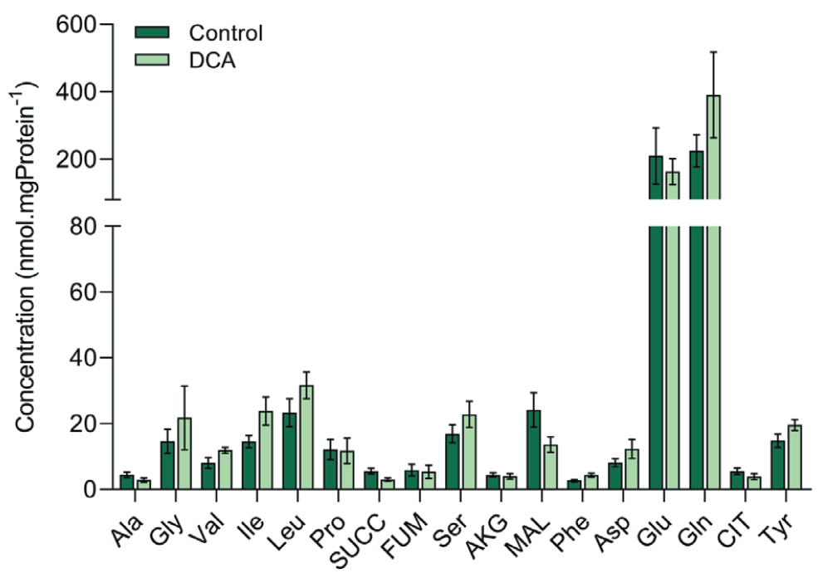
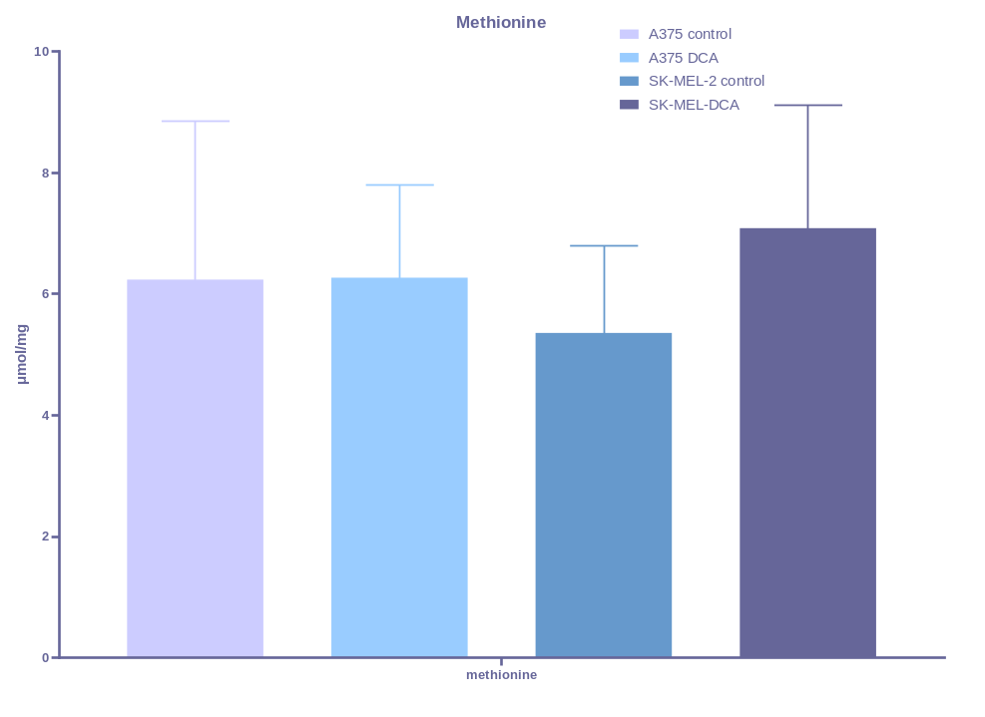
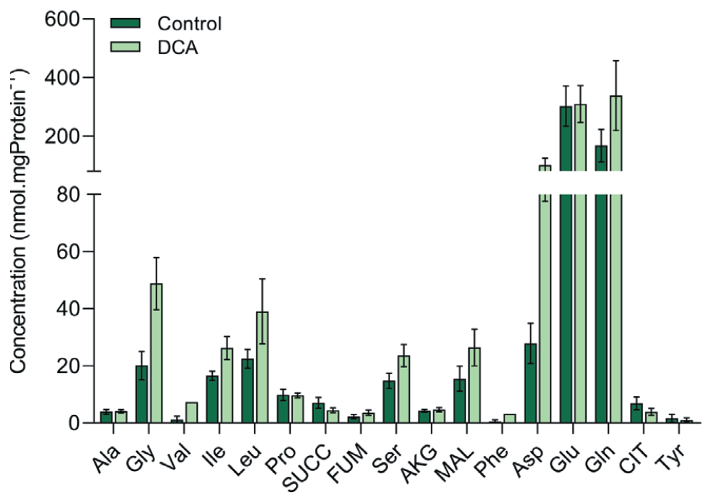
Concentration change in cell lines
A375
SK-MEL-2

Slide 43
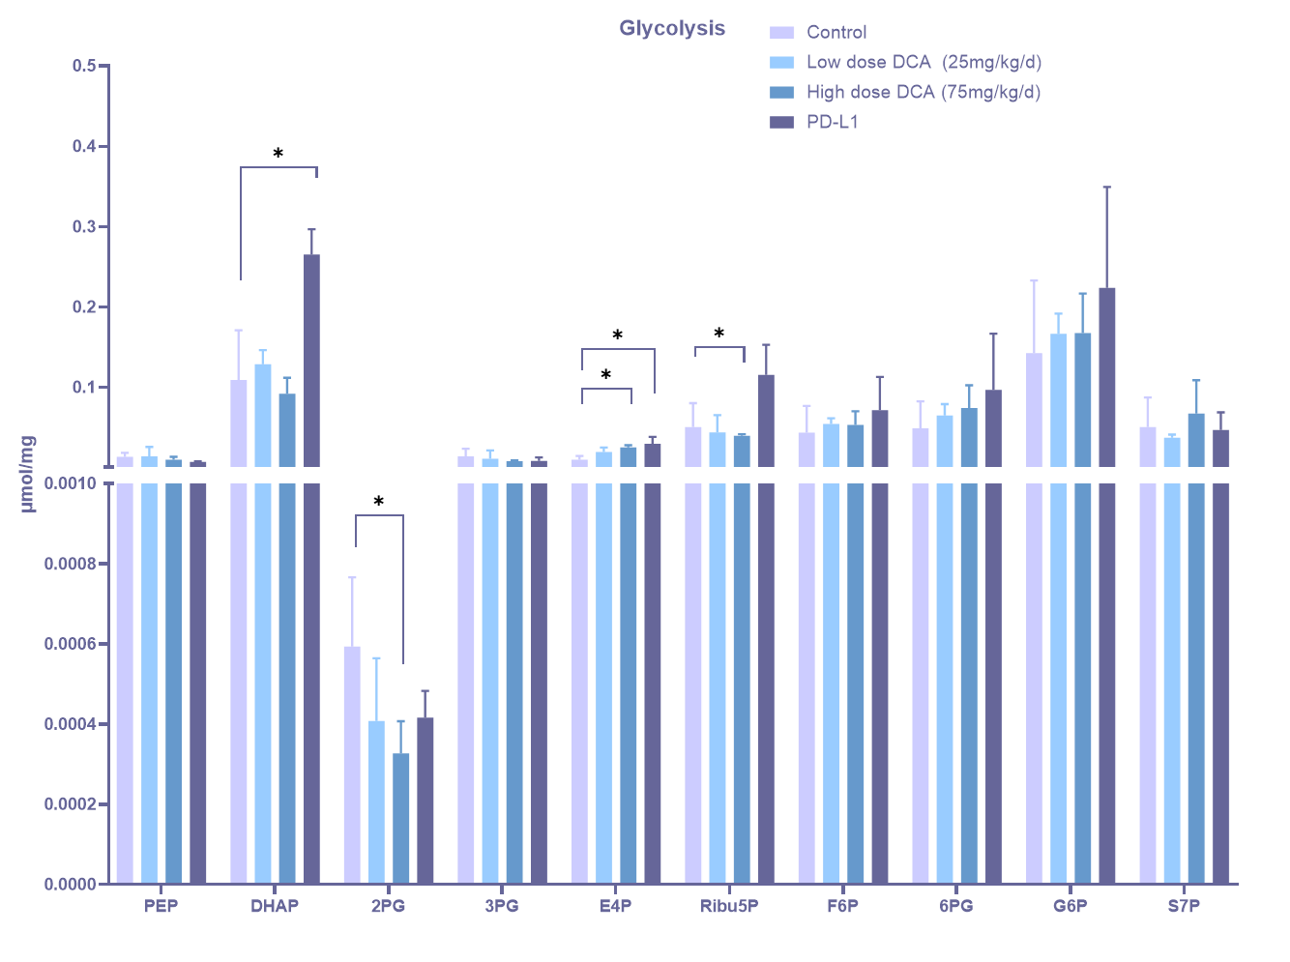
Does DCA changed the glycolysis and PPP intermediates concentration?

Slide 44
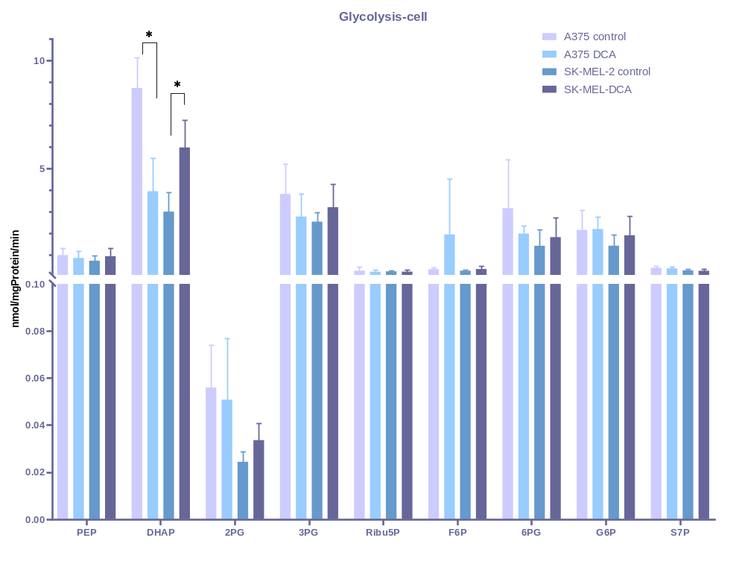
Concentration change in cells

Slide 45
A375

Slide 46
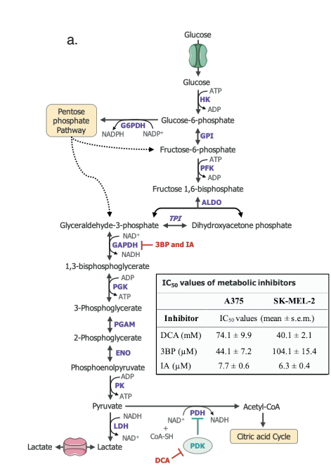
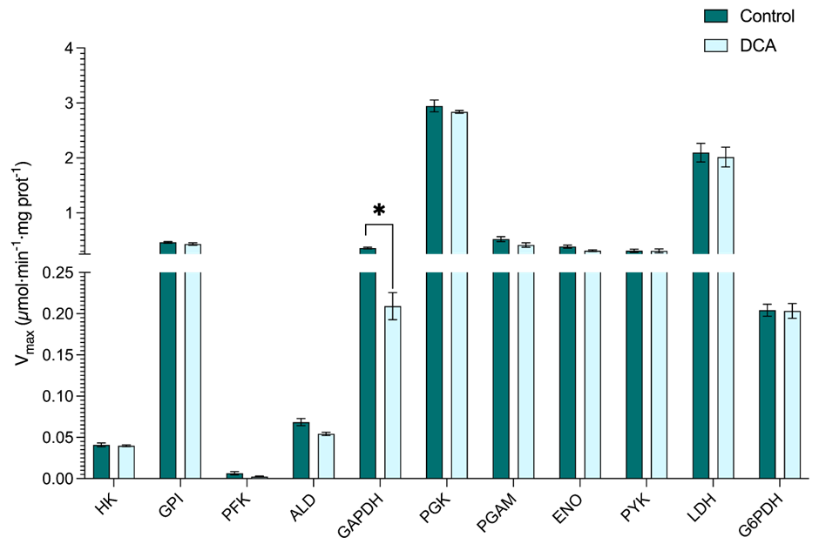
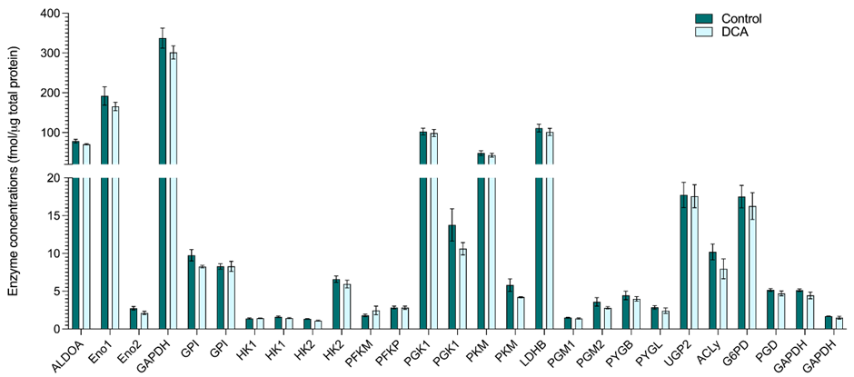
SK-MEL-2 Control vs. DCA

Slide 47
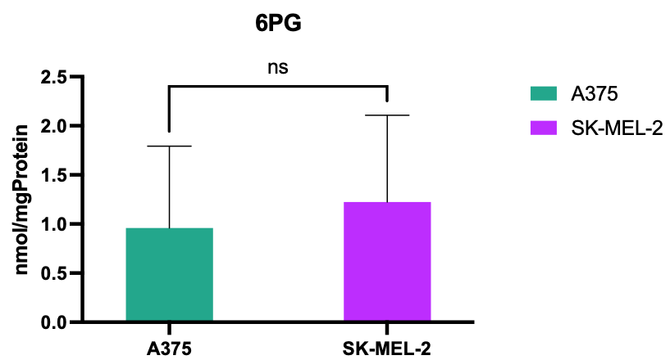

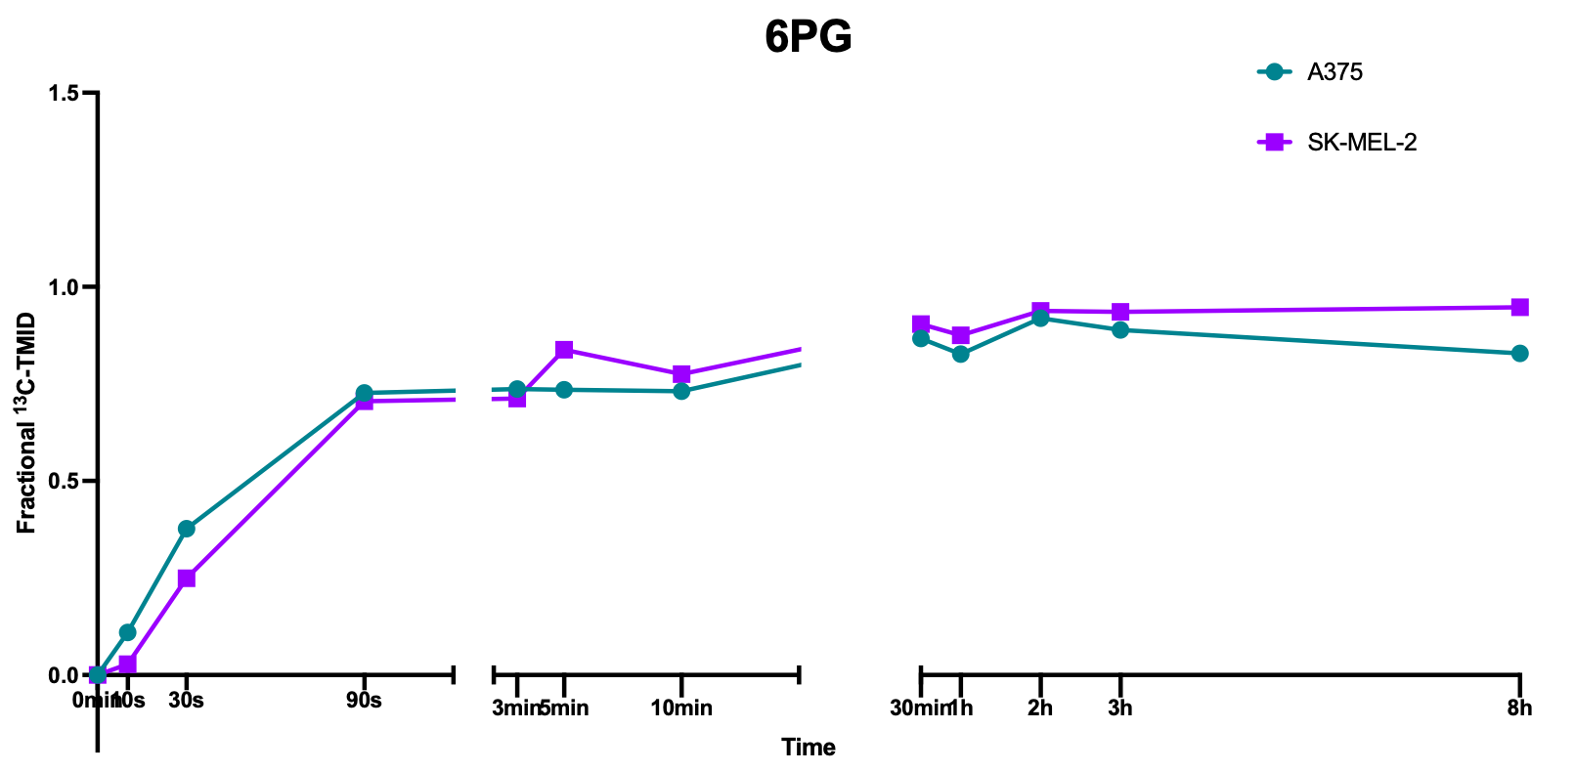
G6P-6PG
Flux calculate by INCA:
A375: 0.0007 nmol*mgProtein⁻¹*min⁻¹
SK-MEL-2: 0.0010 nmol*mgProtein⁻¹*min⁻¹
Concentration
6PG
Labelling pattern

Slide 48
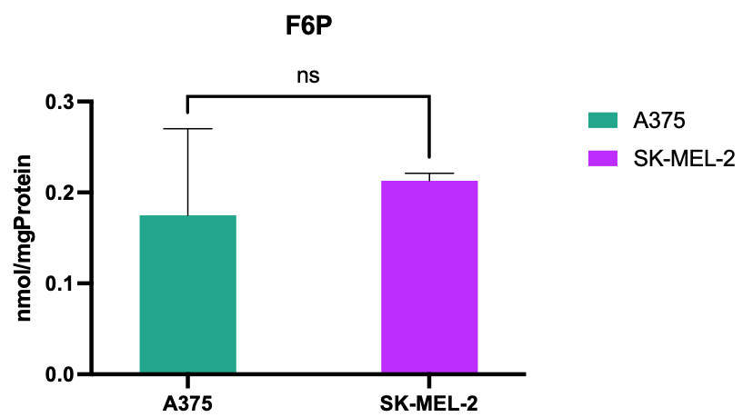
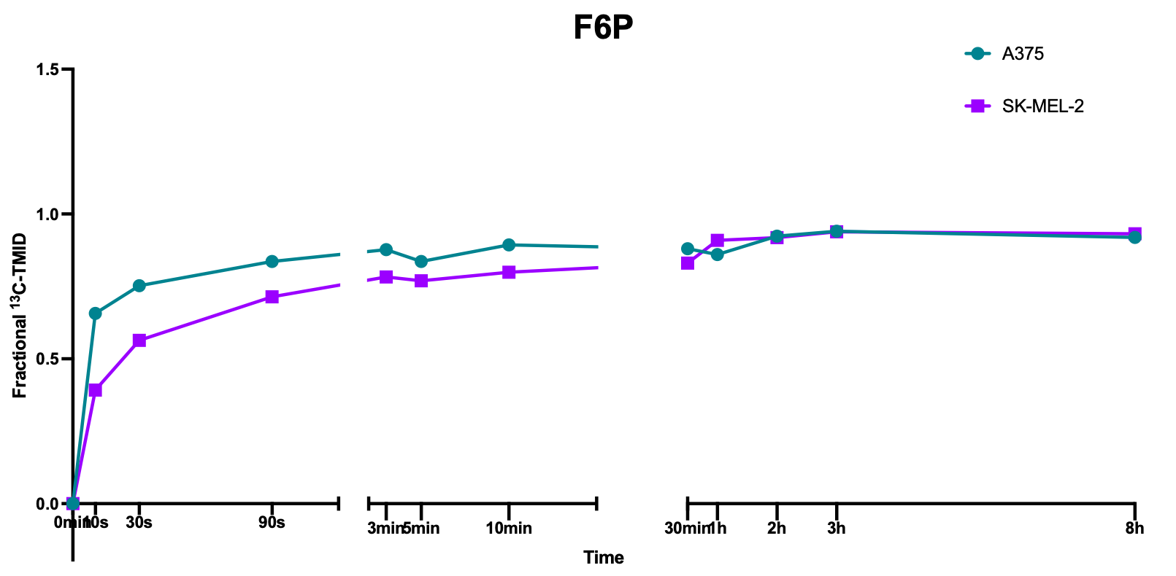
G6P-F6P
Flux calculate by INCA:
A375: 0.00033 nmol*mgProtein⁻¹*min⁻¹
SK-MEL-2: 0.0026 nmol*mgProtein⁻¹*min⁻¹
Concentration
Labelling pattern

Slide 49
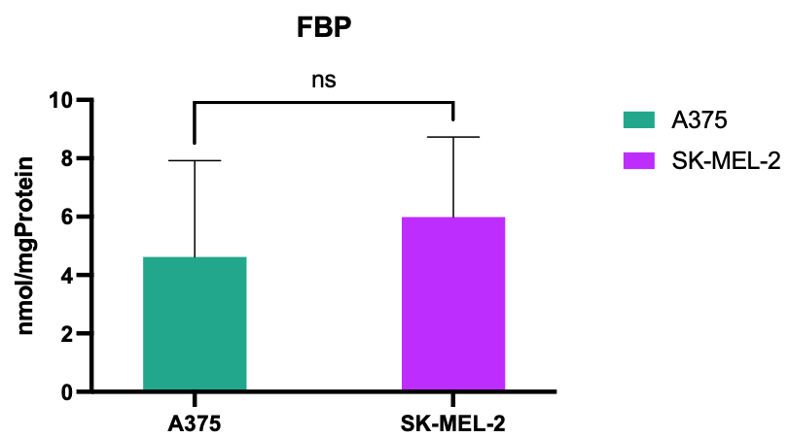
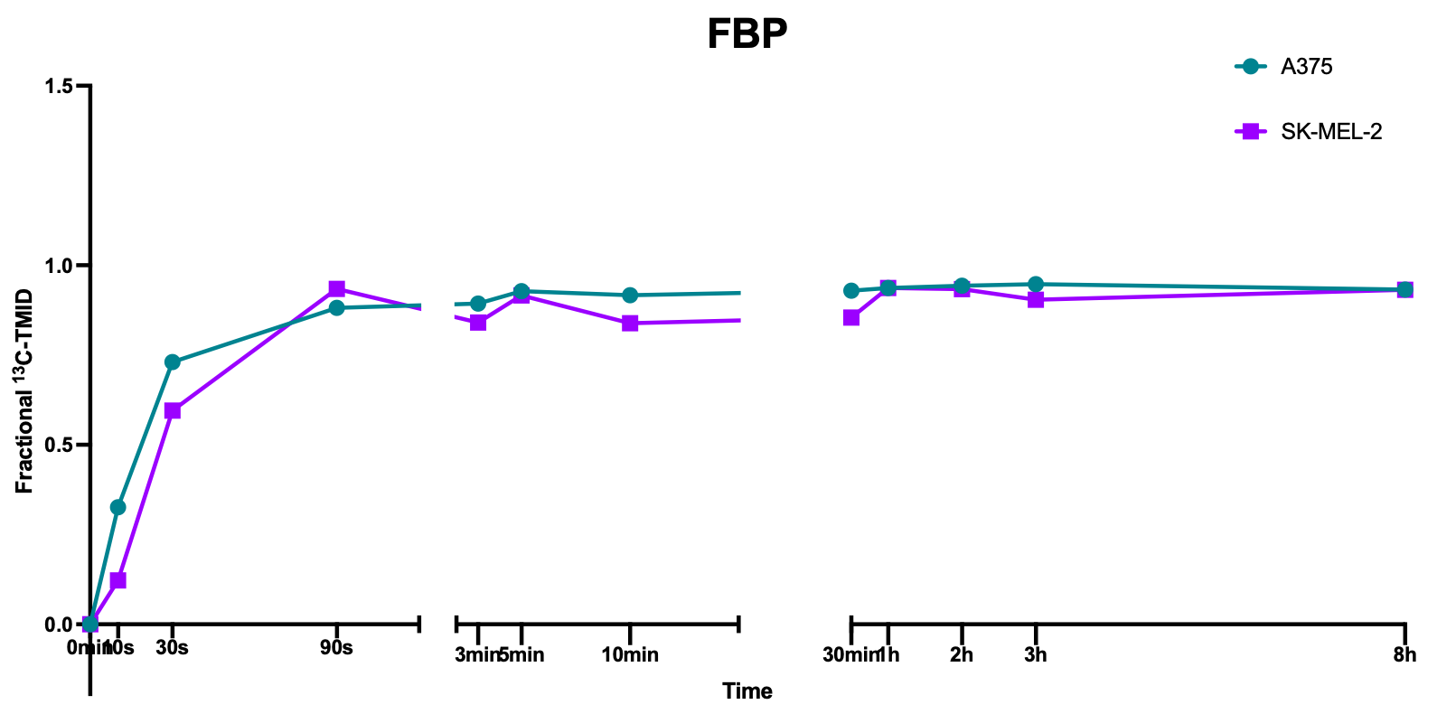
F6P-FBP
Flux calculate by INCA:
A375: 0.00037 nmol*mgProtein⁻¹*min⁻¹
SK-MEL-2: 0.0033 nmol*mgProtein⁻¹*min⁻¹
Concentration
Labelling pattern

Slide 50
Metabolic phenotype of A375/SK-MEL-2
The A375 cells :
Highly glycolytic phenotype and high lactate production
The ratio of PPP/glycolysis is 38.4%
The SK-MEL-2 :
Less active glycolysis pathway
The ratio of PPP/glycolysis is 21.2%

Slide 51

The metabolic phenotype of two cell lines after treatment by DCA
Uptake
Production
?
Evers, B. (2022). Repurposing an old drug
Notes:
In line with the small effect of DCA on glucose consumption, there were only a few changes in the Vmax values and protein concentrations of the glycolytic enzymes.
A375,g6pdh,Vmax increase，small fraction g6p to ppp。

Slide 52

Vmax of G6PDH in A375 up regulated

Slide 53
A375 Control vs. A375 DCA treat group

Slide 54


Glucose to G6P
Flux calculate by INCA:
Control: 0.0040nmol*mgProtein⁻¹*min⁻¹
DCA: 0.0042nmol*mgProtein⁻¹*min⁻¹
Concentration
Labelling pattern
Control
DCA

Slide 55


G6P-6PG
Flux calculate by INCA:
Control: 0.0007nmol*mgProtein⁻¹*min⁻¹
DCA: 0.0012nmol*mgProtein⁻¹*min⁻¹
Concentration
6PG
Labelling pattern
Control
DCA

Slide 56


G6P-F6P
Flux calculate by INCA:
Control: 0.0033nmol*mgProtein⁻¹*min⁻¹
DCA: 0.0030nmol*mgProtein⁻¹*min⁻¹
Concentration
Labelling pattern
Control
DCA

Slide 57


F6P-FBP
Flux calculate by INCA:
Control: 0.0037nmol*mgProtein⁻¹*min⁻¹
DCA: 0.0038nmol*mgProtein⁻¹*min⁻¹
Concentration
Labelling pattern
Control
DCA

Slide 58
4. Future Plan
Complete the INCA model for glycolysis, PPP, and TCA
Positive control

Slide 59
DHEA：Competitive inhibition of the NADP⁺ binding site
6-Aminonicotinamide：
Simultaneously inhibit G6PD and 6PGD
3BP/IA

Slide 60



Estimated CAC fluxes at 8 h after addition of [U-13C] glucose by INCA for A375 and SK-MEL-2 cells.
Evers, B. (2022). Repurposing an old drug

Slide 61



Evers, B. (2022). Repurposing an old drug

Slide 62

Heatmap of the absolute concentrations of oxidative metabolism-related enzymes and transporters in A375 and SK-MEL-2 cells
Evers, B. (2022). Repurposing an old drug

Slide 63



Slide 64



A375 TCA flux
Evers, B. (2022). Repurposing an old drug

Slide 65

SK-MEL-2 TCA flux
Evers, B. (2022). Repurposing an old drug

Slide 66


Evers, B. (2022). Repurposing an old drug

Slide 67


PDH activated by DCA
A high ratio ACO2:CS, allows smooth oxidation, maintaining or even increasing lactate release

Slide 68


DCA potentiates inhibitory effects of CD8+ T cells on melanoma cells
Tiersma, Jiske F et al.
Notes:
Coculture with CD8+ T cells led to a decrease in A375 cell growth. DCA treatment potentiated this effect, both at a dose near its IC50 value for tumour cell growth and at a lower dose known to induce metabolic reprogramming
Coculture with A375 cells alone did not increase IFN-γ secretion by CD8+ T cells
In both monoculture and coculture conditions, DCA increased Interferon gamma IFN-γ secretion by CD8+ T cells, although significance was not reached in the coculture condition.
Preactivated T cells maintain growth inhibition and cytotoxicity even when PDK1 activity is effectively inhibited by DCA

Slide 69
2. Project aims and Approach

Slide 70

Method for measuring 13C labelled amino acids
Enzyme activities
Glycolytic target protein measurement
Intermediates in glycolysis
NOW
.
Notes:
bb99f646-cec8-4ec9-804b-eed67acde796.source.default.zh-Hans

Slide 71

Develop and validate a GC-MS/MS method for the simultaneous quantification of absolute concentrations and isotopologue distributions of phosphorylated sugars

Slide 72
Checklist for method establishment
Scans
Optimization | Split ratio test
 | Derivatisation time
Calibration Curve
Validation | Intra-assay
 | Inter-assay
 | Recovery
 | Repeatability
 | ¹³C-label quantification
 | Split ratio test

Slide 73

List of phosphate sugars
6PG
G6P
E4P
F6P
D
S7P
FBP
D
D
Rib5P
D
DHAP
D
3PG
D
2PG
PEP

Slide 74
Checklist for method establishment
 |  | Done | To do | To improve
Scans |  | √
Optimization | Split ratio test | √ Splitless 2ul
 | Derivatisation time | √
Calibration Curve |  | √
Validation | Intra-assay |  | √
 | Inter-assay |  | √
 | Recovery |  |  | √
 | Repeatability | √
 | ¹³C-label quantification |  | √
 | Matrix Effect | √

Slide 75

Sample preparation
Internal standard
G6P
781712
1362924
Ratio=1362924/781712=1.7435
Notes:
XY轴是什么
根据衍生时间选择峰

Slide 76

Sample preparation
Extraction-LLE
Derivatisation Experiment
Before
After
Water+Methanol
Chloroform
increase in the volatility
Reduction of active sites
Become less polar
1.49 g/cm³
Notes:
G6P is so polar
increase in the volatility——decrease the boiling point
Reduction of active sites——increase in the thermal stability
Become less polar ——dissolved in the non-polar reagents
解释完而为什么萃取解释利用沸点分离

Slide 77

Method Validation
Repeatability
Same sample injected many times

Slide 78

Matrix(sample) effect
Compounds+cells
Standard
Calibration Curve+cells
Calibration Curve

Slide 81

3.4 Validation
Quantification of p-sugars and method performance by GC-MS/MS

Slide 82




Ribu5P
Rib5P

Slide 83

Method-13C-fluxomics

Slide 84
Cell-line-specific computational models

Slide 85

Establish Model

Slide 86


S
1
X
Notes:
In real pathways:
Metabolic flux is regulated by multiple enzymes, and there is usually no single "rate-limiting step.“
Enzymes in metabolic pathways do not directly interact with each other but regulate indirectly through changes in metabolite concentrations.
Flux control coefficients and elasticity coefficients can quantify the role of enzymes in metabolic pathways.

Slide 87


Slide 88

Flux simulate in COPASI

Slide 89
Conclusion
We almost finished the method validation
This method will be used to measure the concentrations and label enrichment
The COPASI model shows the same trend as the real experiment

Slide 90
4. Future Plan
Finish the method establishment
Quantify the response of multiple glycolytic and oxidative melanoma cell lines to treatment with DCA
Construct and analyse a cell-lines-specific computational model of glucose metabolism in melanoma cells to predict real response in patients
Validate and improve the model which will be used in vivo data

Slide 91

Safety moment
Don’t roll up the sleeves
especially those of shared lab coats

Slide 92

Reimbursement of cost in Insite
When you ask for reimbursement of cost in Insite, you must add the correct form:
The Reimbursement form
You can find this forms in Teams:
Research lab. Pediatrics
General
Finance forms
Insite Reimbursement form
This method of declaring applies
to everyone except scholarship students
Notes:
Important to use this form because the one who approves the applications in Insite, does not know all project codes by heart and needs to know that it is approved by the manager.

Slide 93



Half maximal inhibitory concentration (IC50) curves of DCA
IC50 values of DCA

Slide 94
Question 4: Cells behave different in patients
DCA causes Hypoxia-inducible factor 1α levels to decrease under hypoxic but not constant oxygen conditions
Notes:
The ability of DCA to reduce Hypoxia-inducible factor 1-alpha HIF-1α levels in hypoxic cells may result in decreased PDK production, increased PDH activity, and a shift in cellular metabolism from glycolysis to glucose oxidation. The shift in metabolism from glycolysis to glucose oxidation is thought to be the primary mechanism by which DCA induces selective cancer cell killing through the production of excess ROS This lack of PDH activity enhances ATP production by increasing anaerobic glycolysis, which is essential for cells to adapt to hypoxia HIF-1α also induces the synthesis of pro-apoptotic proteins, such as BNIP3 and Noxa, and therefore, a decrease in HIF-1α levels may lead to increased cell viability

Slide 95
Precursor ion and Product ions
Notes:
Multiple reaction monitoring (MRM) is the most common method for quantitation of analytes by MS/MS. In MRM, ions are selected to make it through the first quadrupole and into the collision cell. These ions are referred to as the precursor, or parent, ion. These ions are fragmented in the collision cell. Certain fragment ions referred to as product, or daughter, ions are selected to make it through the second quadrupole. The transition from precursor/parent ion to product/daughter ions is referred to as an ion transition.

Slide 96




Optimize the derivatisation time
Time point 1
Time point 12
Time point 24
One time point=one injection=52min

Slide 97


Precursor ion and Product ions
Why we need transitions?
What is Multiple reaction monitoring (MRM) ?
Precursor ion
Product ion
Notes:
Selectivity more sensitive
Lose all background

Slide 98


Optimize the derivatisation time

Slide 99

℃
Derivatisation Experiment——Why?
G6P’s boiling point is 667.8 ˚C
Temperature Limits for the column: 60 to 360/370 ˚C
Derivatisation Experiment
Notes:
Temperature, gas flowing across the peaks, column chemistry, the column internal pressure gradient, and temperature drive the peaks along. Oven temperature is the main driver for GC peaks. That means the oven temperature influence the retention time significantly.

Slide 100




Derivatisation Experiment——Protocol
Protect aldehyde group
Methoxyamine hydrochloride
1%
Replace active hydrogens
G6P
A weakening of the hydrogen bonding forces and an increase in the volatility of the derivatized compound——decrease the boiling point
Reduction of active sites——increase in the thermal stability
Become less polar ——dissolved in the non-polar reagents
Notes:
Oximisation is a reaction in which compounds containing carbonyl groups (e.g. aldehydes and ketones醛、酮) interact with hydroxylamines to produce compounds containing C=NOH groups. This process protects the ketone and aldehyde groups, especially for saccharides, and is effective in avoiding some of the more complicated reactions. For some compounds with high polarity, the polarity of the compound can be drastically reduced by introducing TMS group. At the same time, the reduction of active sites in the compound due to the substitution of active hydrogens results in an increase in the thermal stability of the derivatives. The reduction of active hydrogen sites in the compound also results in a weakening of the hydrogen bonding forces and an increase in the volatility of the derivatised compound. The reagents used in derivatisation are basically non-polar reagents. So some polar compounds undergo derivatisation, it becomes less polar and gets dissolved in the non-polar reagents, while those that cannot be derivatised and at the same time cannot be dissolved, form a precipitate(沉淀） at the bottom. Translated with DeepL.com (free version)This reaction is mainly a process in which reactive hydrogens in substances (e.g. substances containing hydroxyl-OH, carboxyl-COOH, amino-NH2, mercapto-SH and phosphoric acid group-H2PO4, etc.) are replaced by silyl groups.
肟化反应是指含有羰基的化合物（如醛、酮类）与羟胺作用而生成含有C=NOH基的化合物的反应。此过程可以保护酮基和醛基，特别是对于糖类物质可以有效避免一些复杂反应的产生。对一些极性较大的化合物，通过引进这个基团能大幅度降低化合物的极性。同时因为活泼氢被取代导致化合物内的活泼位点减少，使得衍生化物的热稳定性增强。化合物内的活泼氢位点减少还带来一个现象，就是氢键作用力减弱，衍生化物的挥发性增强。衍生化所用的试剂基本都是非极性的试剂。所以一些极性化合物经过衍生化，它的极性变小，被溶解在非极性的试剂中，而那些不能被衍生化，同时也无法被溶解，就会在底部形成沉淀。

Slide 101


3.2 Precursor ion and Product ions
Why we need transitions?
What is Multiple reaction monitoring (MRM) ?
Removal of non-conforming signal interference for high sensitivity, accuracy and specificity
MS1
MS/MS
Notes:
Multiple reaction monitoring (MRM) is the most common method for quantitation of analytes by MS/MS. In MRM, ions are selected to make it through the first quadrupole and into the collision cell. These ions are referred to as the precursor, or parent, ion. These ions are fragmented in the collision cell. Certain fragment ions referred to as product, or daughter, ions are selected to make it through the second quadrupole. The transition from precursor/parent ion to product/daughter ions is referred to as an ion transition.

Slide 102


